Slide 1

Academic Integrity
An important conversation
Notes:
Licensed by the Centre for the Advancement of Teaching and Learning at the University of Manitoba
under Creative Commons: Attribution-NonCommercialShareAlike 4.0 International (CC BY-NC-SA 4.0)
You are free to:
Share — copy and redistribute the material in any medium or format
Adapt — remix, transform, and build upon the material
for any purpose, even commercially.
The licensor cannot revoke these freedoms as long as you follow the license terms.
Under the following terms:
Attribution — You must give appropriate credit, provide a link to the license, and indicate if changes were made. You may do so in any reasonable manner, but not in any way that suggests the licensor endorses you or your use.
ShareAlike — If you remix, transform, or build upon the material, you must distribute your contributions under the same license as the original.
No additional restrictions — You may not apply legal terms or technological measures that legally restrict others from doing anything the license permits.
Notices:
You do not have to comply with the license for elements of the material in the public domain or where your use is permitted by an applicable exception or limitation.
No warranties are given. The license may not give you all of the permissions necessary for your intended use. For example, other rights such as publicity, privacy, or moral rights may limit how you use the material.

Slide 2
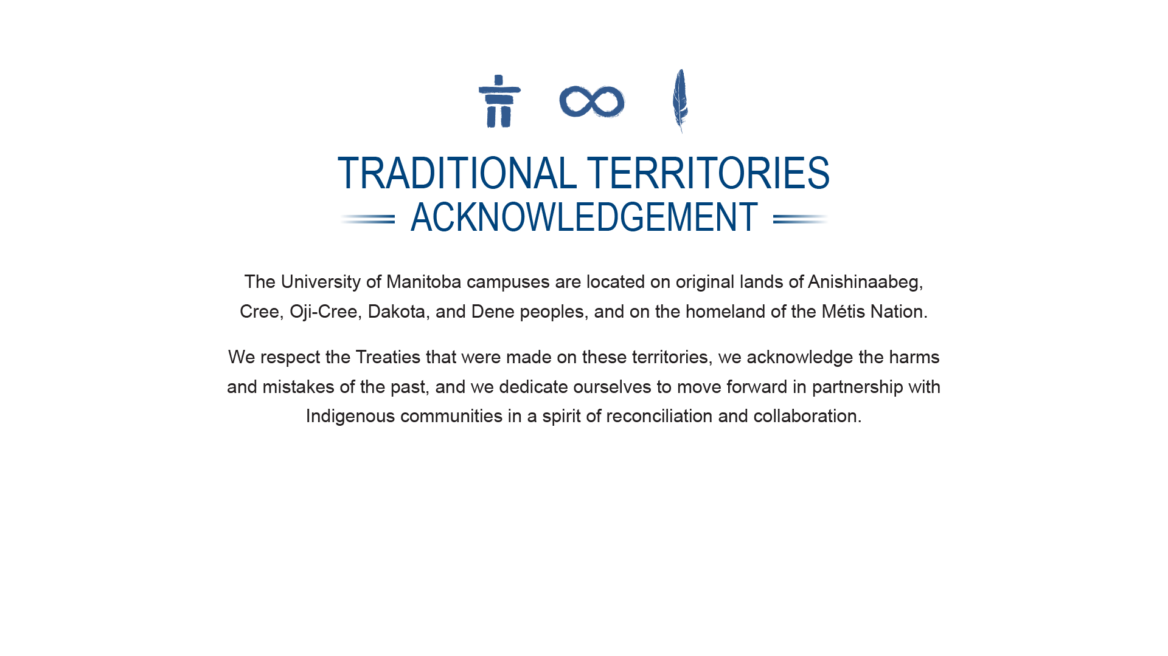

umanitoba.ca

Slide 3
Questions to discuss with students
What is academic integrity?
  Why should students care about academic integrity?
What are the various types of academic dishonesty?
What are the expectations in this class?
Where can students go for more information?
umanitoba.ca
Notes:
Note to University Teachers:
As part of your first class of the term, you may wish to set aside some time to discuss academic integrity with your students.
To help you prepare for this discussion, this slide deck, containing a list of questions that you may wish to discuss with your students, has been prepared and made available. You may modify/delete/add to these slides as appropriate for your teaching and learning environment.

Slide 4
What is academic integrity?
umanitoba.ca

Slide 5
What is academic integrity?
Integrity
adherence to moral and ethical principles
soundness of moral character
honesty (dictionary.com)
What is academic integrity?
honesty in coursework and research
umanitoba.ca
Notes:
The idea of Academic Integrity was developed most fully through the work of the International Centre of Academic Integrity (ICAI; academicintegrity.org/icai/resources-4.php) located at Duke University.
Academic integrity is described in a document titled “The Fundamental Values of Academic Integrity” (http://www.academicintegrity.org/icai/assets/Revised_FV_2014.pdf).
If you decide to explore this document, it is licensed under a Creative Commons License, and can be shared (i.e., material may be copied and redistributed in any medium or format) and adapted (i.e., material may be remixed, transformed, and built upon).

Slide 6

Academic Integrity
academicintegrity.org
umanitoba.ca
Notes:
At the University of Manitoba, the university community adheres to the values of academic integrity identified in the document, “The Fundamental Values of Academic Integrity”.
The values include honesty, trust, fairness, responsibility, and respect, and the courage to uphold these values.

Slide 7
Why should students care about academic integrity?
umanitoba.ca

Slide 8
Why should students care about academic integrity?
Eliminates unfair advantage between students
Foundation of your university degree
  Gives your degree value
Builds moral character
Prepares students for future life and work demands
umanitoba.ca

Slide 9
What are the various types of academic misconduct?
umanitoba.ca
Notes:
The following slides provide definitions and examples of the six most common forms of academic dishonesty.
These definitions and examples were compiled by members of the Academic Integrity Working Group (AIWG) and Associate Dean’s representing various faculties, using our own experiences and documents from the Office of Student Advocacy as resources for their preparation. They are now part of the Student Academic Misconduct Procedures (see Part II at http://umanitoba.ca/admin/governance/media/Student_Academic_Misconduct_Procedures_-_2016_09_01.pdf).

Slide 10
Cheating
Duplicate submission
Personation
Academic Fraud
Plagiarism
Inappropriate collaboration
umanitoba.ca

Slide 11
Plagiarism
“the presentation or use of information, ideas, sentences, findings, etc. as one’s own without appropriate citation in a written assignment, test or final examination.”
This definition is located in the Student Academic Misconduct Procedure.
umanitoba.ca
Notes:
Alternate text you could present to your students:
Using others’ ideas, findings, information, or the words they use to express any of these, without giving them credit for those ideas or words. Plagiarism can also include improper citing/referencing, even when a student did not mean to do anything wrong or thought they cited correctly. This is unintentional plagiarism. Unintentional plagiarism happens when students do not know how to write, edit, and cite properly, and make mistakes in their writing. Anyone may plagiarize unintentionally.

Slide 12
Copying text (even if from the instructor’s notes or course textbook) verbatim, without including it in quotation marks and citing the source.
Copying non-written media (e.g., part of or entire diagrams, tables, graphs, maps, images, pictures, or photos) without proper referencing or permissions.
Copying sentences and changing some words without proper citation or acknowledging the source of the ideas or information.
Presenting an idea, summary of information, etc., without acknowledging the source of those ideas or information.
Examples of Plagiarism
Source: These examples were compiled by members of the Academic Integrity Working Group (AIWG) and Associate Dean’s representing various faculties, using experiences and documents from the Office of Student Advocacy as resources for their preparation.
umanitoba.ca
Notes:
Other examples of plagiarism that instructors may wish to highlight. Please feel free to replace the examples in the slide with something specific to your course or one of more of the following:
Including citations and/or reference that are incorrect or made up with apparent dishonest intentions.
Not including all citations in a bibliography or reference list.
Self-plagiarism can also occur when students use parts of a previously submitted paper submitted without proper citation and without the instructor’s permission to self-attribute.

Slide 13
“the circumventing of fair testing procedures or contravention of exam regulations. Such acts may be premeditated/planned or may be unintentional or opportunistic.”
Cheating
This definition is located in the Student Academic Misconduct Procedure.
umanitoba.ca
Notes:
Alternate text you could present to your students:
Cheating on Quizzes, Tests, or Final Exams: When a student does anything during an in-class quiz, test, or a final exam to make the conditions no longer fair for everyone, and some students have an advantage over others. Actions such as looking at others’ tests, or allowing someone to look at their test/answer sheet, are both examples of cheating. This also includes actions outside the classroom, such as getting old test questions without permission.

Slide 14
“Looking at another student’s paper or screen during an examination.
“Allowing other students to view/use answers during a test or examination.
“Possession of unauthorized materials in the examination room that could help performance on the exam.”
Examples of Cheating
Source: These examples were compiled by members of the Academic Integrity Working Group (AIWG) and Associate Dean’s representing various faculties, using experiences and documents from the Office of Student Advocacy as resources for their preparation.
umanitoba.ca
Notes:
Other examples of cheating that instructors may wish to highlight. Please feel free to replace the examples in the slide with one or more of the following:
Possession of unauthorized materials that may aid another student in cheating (e.g., positioning study notes in a way that other students could see them).
Using unauthorized materials for an online assignment or test (e.g., cell phones, cheat sheets, calculators, dictionaries, etc.).
Accessing unauthorized materials (e.g., using cell phone or other material while taking bathroom breaks during an exam).
Passing notes, talking, texting/email or engaging in other forms of communication with others during a test or examination whether related to the course material or not.
Sharing answers or questions with other students prior to or during a test/exam. It is considered cheating if questions or answers are shared after the test/exam with students who haven’t taken the test/exam yet (e.g., makeup exam or another section of the course) and sharing answers in take-home exams.
Sharing materials (e.g., calculator, cheat sheet, dictionary) with another student during a test/exam without permission from the instructor or invigilator.
Obtaining test questions or answers prior to or during a test or examination from any source.
Obtaining the answer key from the student-grader or any other source.
Asking student-grader for favorable treatment before an exam/assignment has been graded. Threatening a grader will warrant additional disciplinary action.
Removing the examination questions from the testing centre, unless authorized. This may also be considered theft.
Selling and/or distributing answers to others prior to a test or examination.
Inappropriate collaboration on take-home assignments, projects, or tests.
Use of stolen examination booklets.
Continuing to write after the test or examination has ended.
Taking pictures of exam items with cell phone
Using recorded class content during exams (e.g. earbuds in ears, listening to recorded lecture or own verbal cheat notes)

Slide 15
“When a student and any other unauthorized person work together on assignments, projects, tests, labs or other work unless authorized by the course instructor.”
Inappropriate collaboration
This definition is located in the Student Academic Misconduct Procedure.
umanitoba.ca
Notes:
Alternate text you could present to your students:
When a student and anyone else work together on a project, take-home test, labs, or other work without clear permission, they are collaborating inappropriately. Projects and tests are often designed to be completed independently. Unless the instructor says that a project may be worked on in groups, students should assume projects are to be completed independently. Inappropriate collaboration can also mean having someone proofread a paper for you, or using social media to share answers.

Slide 16
Examples of Inappropriate collaboration
Seeking substantial help or working together on part or all of an assignment of any sort - without permission. Students are encouraged to carefully read assignment instructions and to ask their instructor if at all unsure about the rules on collaboration for any assignment, quiz, lab or test. Having someone proofread a paper for language correctness is not considered inappropriate collaboration, if permission is sought from the instructor before doing so. Proofreader is not to help with the academic content of the paper.
Dishonest use of old assignments and tests for the purpose of completing new assignments, e.g., stealing tests from examination rooms, distributing exams when told not to do so.
Source: These examples were compiled by members of the Academic Integrity Working Group (AIWG) and Associate Dean’s representing various faculties, using experiences and documents from the Office of Student Advocacy as resources for their preparation.
umanitoba.ca
Notes:
Other examples of inappropriate collaboration that instructors may wish to highlight. Please feel free to replace the examples in the slide with one or more of the following:
Creation of a social media site or website for sharing, selling, and/or copying course materials without authorization by the course instructor.
Submission of material written or created by someone else, whether in part or in its entirety. This may also be considered plagiarism.
Aiding other students by providing consultation, advice and/or engaging in collaboration on assignments.

Slide 17
Plagiarism
“cheating where a student submits a paper, assignment, or test in full or in part, for more than one course without the permission of the course instructor.”
Duplicate submission
This definition is located in the Student Academic Misconduct Procedure.
umanitoba.ca
Notes:
Alternate text you could present to your students:
Duplicate Submission: A student submits the same paper or assignment, in full or in part, to more than one course. Even copying and pasting a paragraph from an old paper into a new one can be duplicate submission. If students want to use ideas from other papers they wrote, they should ask their course instructor of the current class.

Slide 18
Examples of Plagiarism
Examples of duplicate submission
“Submitting a paper written and graded for another course.
“Submitting data, images, diagrams, tables or maps that were completed for another course without proper citation and without permission from the instructor.
“Submitting labs or other assignments written or graded for the same or another course.”
Examples of Duplicate submission
Source: These examples were compiled by members of the Academic Integrity Working Group (AIWG) and Associate Dean’s representing various faculties, using experiences and documents from the Office of Student Advocacy as resources for their preparation.
umanitoba.ca

Slide 19
Personation
“writing an assignment, lab, test, or examination for another student, or the unauthorized use of another person’s signature or identification in order to impersonate someone else. Personation includes both the personator and the person initiating the personation.”
This definition is located in the Student Academic Misconduct Procedure.
umanitoba.ca
Notes:
Alternate text you could present to your students:
Personation means writing a lab, assignment, test, or exam for another student. Personation can also mean signing an attendance sheet or some other form of identification for somebody else.

Slide 20
Examples of personation
“Writing a paper, assignment or lab for another student.
“Attending and writing a test or examination for another student.
“Use of false identification or a fake signature of another person to write an examination or obtain services from the university.
“Recording attendance for another student.
Examples of Personation
Source: These examples were compiled by members of the Academic Integrity Working Group (AIWG) and Associate Dean’s representing various faculties, using experiences and documents from the Office of Student Advocacy as resources for their preparation.
umanitoba.ca
Notes:
Other examples of personation that instructors may wish to highlight. Please feel free to replace the examples in the slide with one or more of the following:
Making online course-related postings pretending to be another student.
Grading a paper or assignment to imply the instructor has graded it.
A student who arranges for another person to write an examination on her or his behalf

Slide 21
Academic Fraud
“falsification of data or official documents as well as the falsification of medical or compassionate circumstances/ documentation to gain accommodations to complete assignments, tests or examinations.”
This definition is located in the Student Academic Misconduct Procedure.
umanitoba.ca
Notes:
Alternate text you could present to your students:
Academic fraud is a very serious offense, and includes: altering data to make it better fit an assignment or a lab, to make the data “right”; altering official documents, such as a medical or compassionate note from a doctor or a therapist, to get accommodations to finish assignments or write exams later; finally, purchasing a paper or assignment through the internet or otherwise to hand into a course.

Slide 22
Examples of Academic Fraud
“Submitting false material for assignment or lab (i.e., made-up data).
“Purchasing a term paper or assignment or paying someone to prepare it (having someone proofread is excluded, unless prohibited by instructor).
“Using a website or social media site to dishonestly complete a paper, assignment or lab.”
Source: These examples were compiled by members of the Academic Integrity Working Group (AIWG) and Associate Dean’s representing various faculties, using experiences and documents from the Office of Student Advocacy as resources for their preparation.
umanitoba.ca
Notes:
Other examples of academic fraud that instructors may wish to highlight. Please feel free to replace the examples in the slide with one or more of the following:
Falsifying or tampering with medical notes or other official documents.
Falsely claiming illness or bereavement.
Falsification on admission applications. This includes false information on admission applications, fake transcripts, and failure to disclose attendance at other universities).
Falisfying signatures on a form.
Submission of falsified institutional forms.
Using a translating device or translator to produce a paper, assignment or lab that was intended to be created in English.
Theft of any kind. This includes stealing computer code, papers, and assignments from other students and/or instructors.
Sabotaging other students’ academic work or work-related equipment of any kind.
Stealing other students’ research ideas. This may also be plagiarism.
Unreasonable hoarding materials or equipment to advance one’s own research or assignments at the expense of others.
Changing answers to a test or examination after it has been graded and returned to the student.
Claiming an assignment was submitted when it wasn’t.
Students may not attend any examination or test for any for which course she or he is not registered

Slide 23
What are the expectations in this course?
umanitoba.ca
Notes:
What are the instructor’s expectations for this class?

Slide 24
What is appropriate in my class:
  Discussion of assignment with other students
  Brainstorming with classmates
  Peer editing
  Asking for clarification on assignment requirements
  Seeking help on how to cite sources
umanitoba.ca
Notes:
The course instructor will need to edit this slide as appropriate for their learning environment.

Slide 25
What is not appropriate:
  Submitting any amount of work written by someone else
  Using ideas, facts, or phrases from someone else without citing
  Submitting work that you submitted in another class
umanitoba.ca
Notes:
The course instructor will need to ask the details to this slide as appropriate.
The contents of this slide act as a guide for what to include.
You may also refer to your syllabus if you had these details outlined in that document.

Slide 26
Where can students get more information?
umanitoba.ca

Slide 27
University of Manitoba Resources
Academic Learning Centre
UM Libraries
Student Advocacy
  Student Conduct: Your Rights and Responsibilities
UM Academic Calendar
Instructor
  Course Syllabus
  Insert Your Office Hours Information
umanitoba.ca

