Slide 1
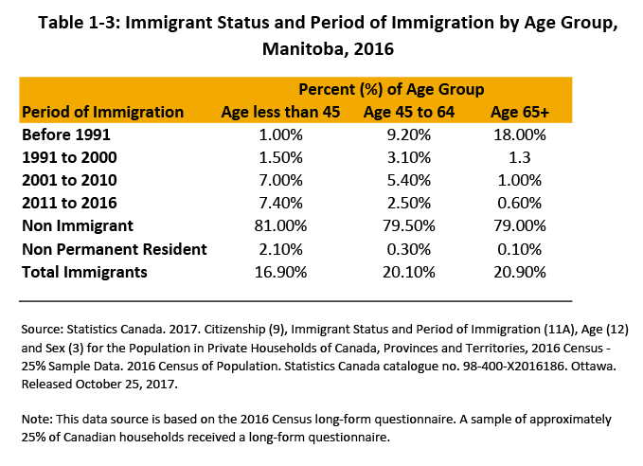
©2019 Centre on Aging, University of Manitoba
Notes:
How to cite this graphic:
Table 1-3: Immigrant Status and Period of Immigration by Age Group, Manitoba, 2016. Reprinted from Facts on Aging: Demographics, by the Centre on Aging, retrieved from http://www.umanitoba.ca/aging
Copyright 2019 by the Centre on Aging, University of Manitoba.

