Slide 1
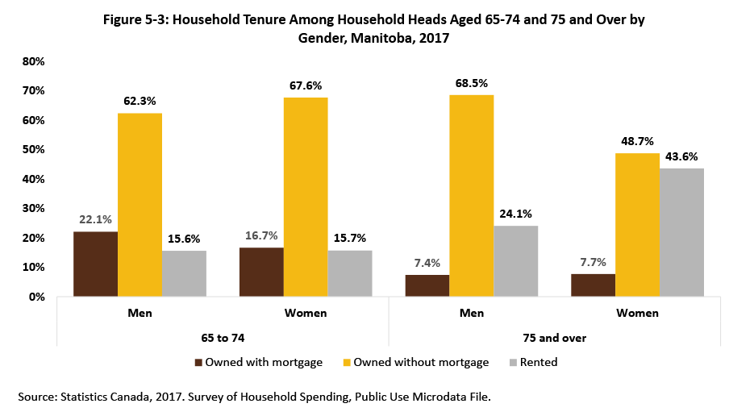

©2020 Centre on Aging, University of Manitoba
Notes:
How to cite this graphic:
Figure 5-3: Household Tenure Among Household Heads Aged 65-74 and 75 and Over by Gender, Manitoba, 2017. Reprinted from Facts on Aging: The older worker, by the Centre on Aging, retrieved from http://www.umanitoba.ca/aging
Copyright 2020 by the Centre on Aging, University of Manitoba.

