Slide 1
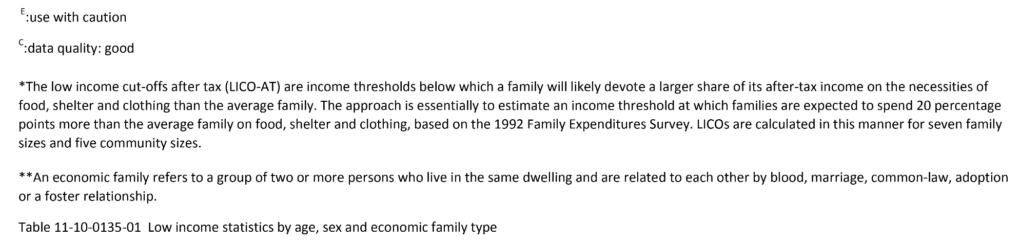
©2022 Centre on Aging, University of Manitoba
Notes:
How to cite this graphic:
Table 5-3: Proportion living below after-tax low income cut-off, population aged 65 and over, Manitoba, 2020. Reprinted from Facts on Aging: Financial well-being, by the Centre on Aging, retrieved from http://www.umanitoba.ca/aging
Copyright 2022 by the Centre on Aging, University of Manitoba.

