Slide 1
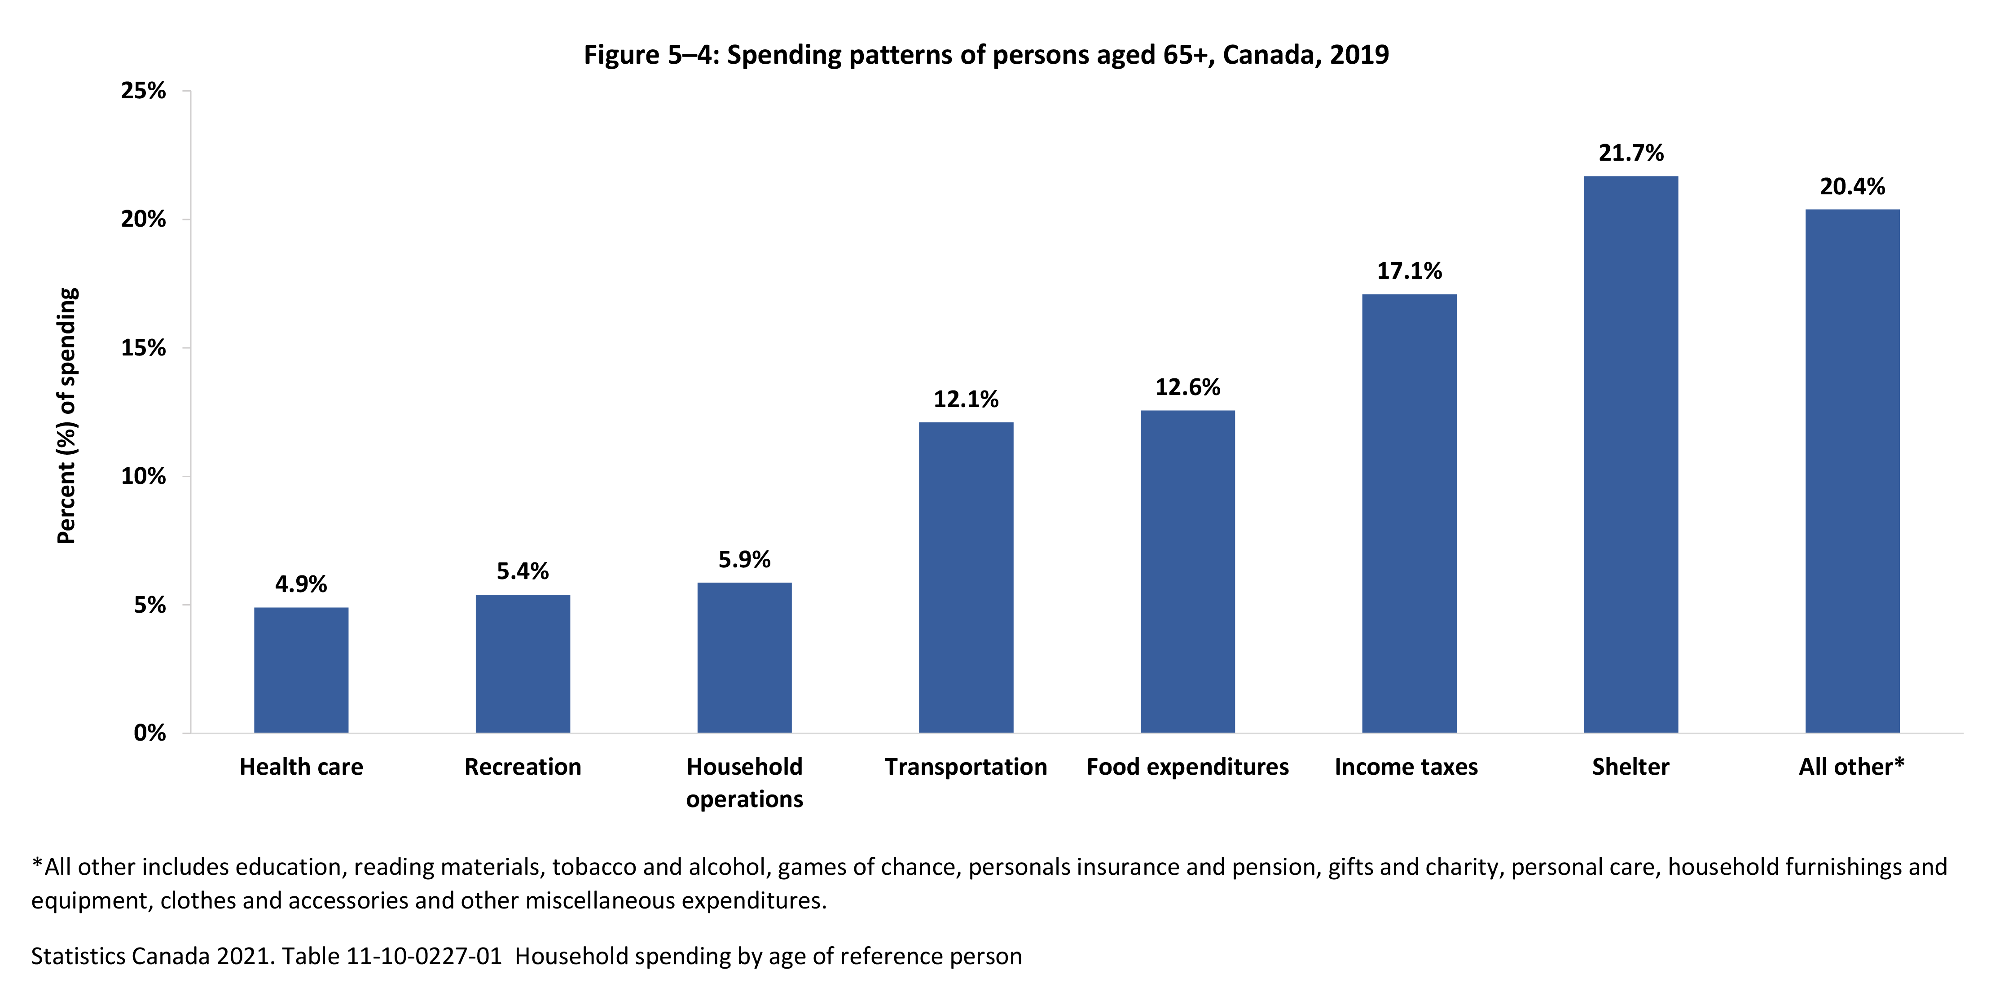
©2022 Centre on Aging, University of Manitoba
Notes:
How to cite this graphic:
Figure 5-4: Spending patterns of persons aged 65+, Canada, 2019. Reprinted from Facts on Aging: Financial well-being, by the Centre on Aging, retrieved from http://www.umanitoba.ca/aging
Copyright 2022 by the Centre on Aging, University of Manitoba.

