Slide 1
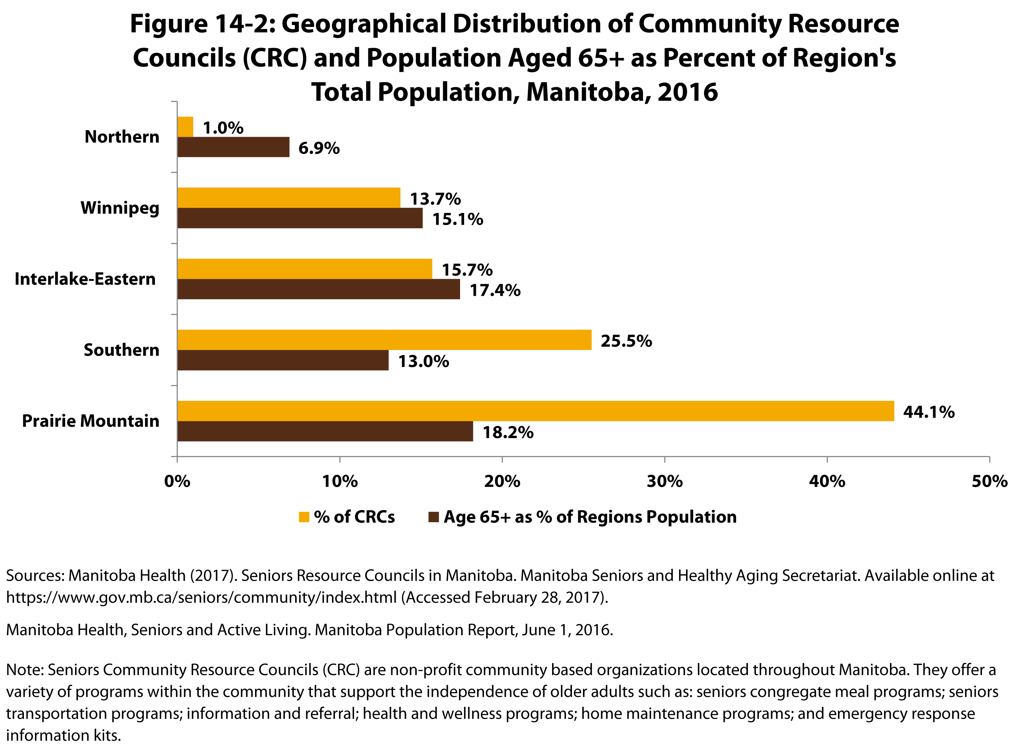

©2017 Centre on Aging, University of Manitoba
Notes:
How to cite this graphic:
Figure 14-2: Geographical Distribution of Community Resource Councils (CRC) and Population Aged 65+ as Percent of Region's Total Population, Manitoba, 2016. Reprinted from Facts on Aging: Health care and community services by the Centre on Aging, retrieved from ttp://www.umanitoba.ca/aging
Copyright 2017 by the Centre on Aging, University of Manitoba.

