Slide 1
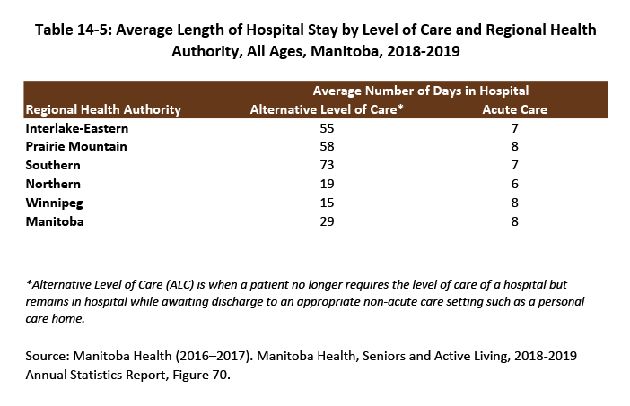
©2020 Centre on Aging, University of Manitoba
Notes:
How to cite this graphic:
Table 14-5: Average Length of Hospital Stay by Level of Care and Regional Health Authority, All Ages, Manitoba, 2018-2019 . Reprinted from Facts on Aging: Health care and community services, by the Centre on Aging, retrieved from http://www.umanitoba.ca/aging
Copyright 2020 by the Centre on Aging, University of Manitoba.

