Slide 1
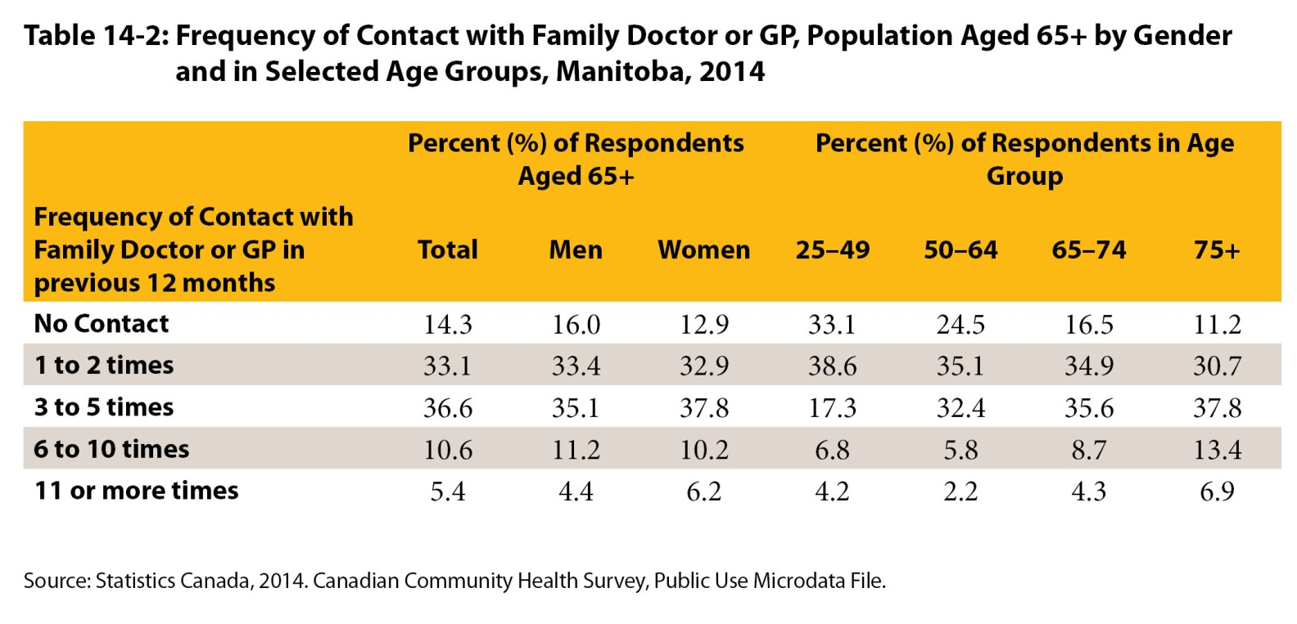
©2017 Centre on Aging, University of Manitoba
Notes:
How to cite this graphic:
Table 14-2: Frequency of Contact with Family Doctor or GP, Population Aged 65+ by Gender and in Selected Age Groups, Manitoba, 2014. Reprinted from Facts on Aging: Health care and community services by the Centre on Aging, retrieved from ttp://www.umanitoba.ca/aging
Copyright 2017 by the Centre on Aging, University of Manitoba.

