Slide 1
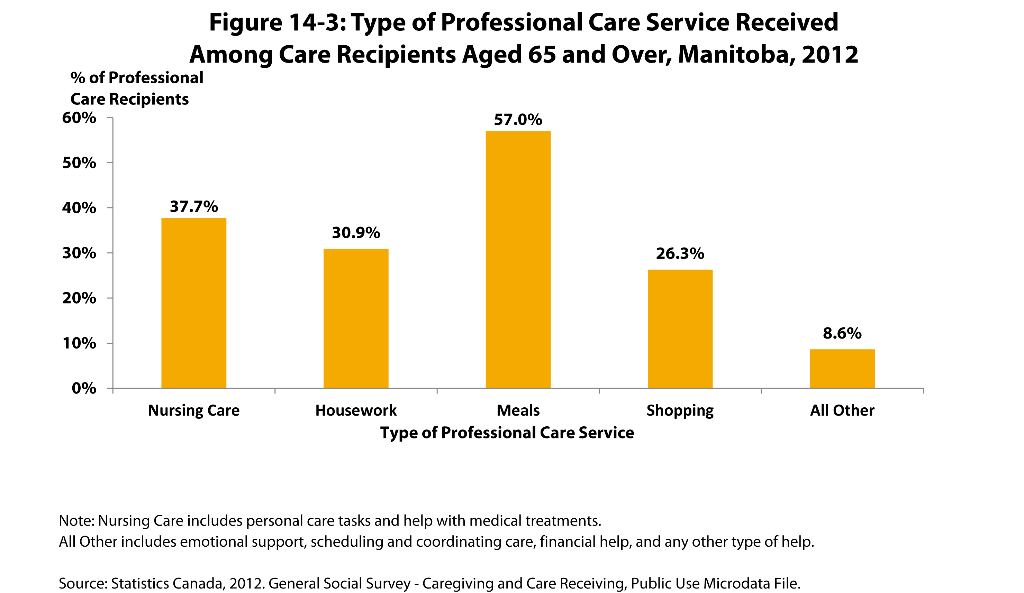

©2017 Centre on Aging, University of Manitoba
Notes:
How to cite this graphic:
Figure 14-3: Type of Professional Care Service Received Among Care Recipients Aged 65 and Over, Manitoba, 2012. Reprinted from Facts on Aging: Health care and community services by the Centre on Aging, retrieved from ttp://www.umanitoba.ca/aging
Copyright 2017 by the Centre on Aging, University of Manitoba.

