Slide 1
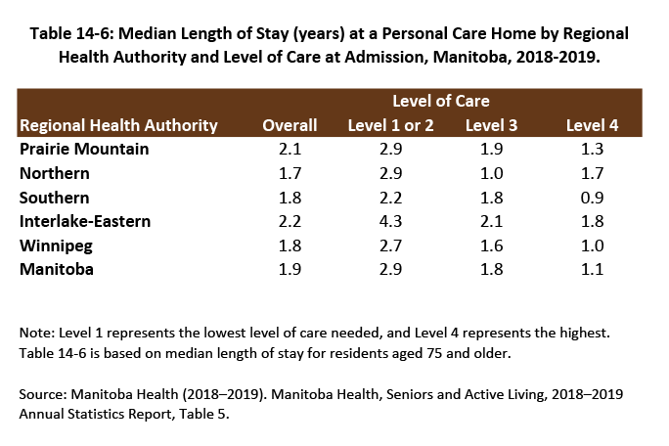
©2020 Centre on Aging, University of Manitoba
Notes:
How to cite this graphic:
Table 14-6: Median Length of Stay (years) at a Personal Care Home by Regional Health Authority and Level of Care at Admission, Manitoba, 2018-2019. . Reprinted from Facts on Aging: Health care and community services, by the Centre on Aging, retrieved from http://www.umanitoba.ca/aging
Copyright 2020 by the Centre on Aging, University of Manitoba.

