Slide 1
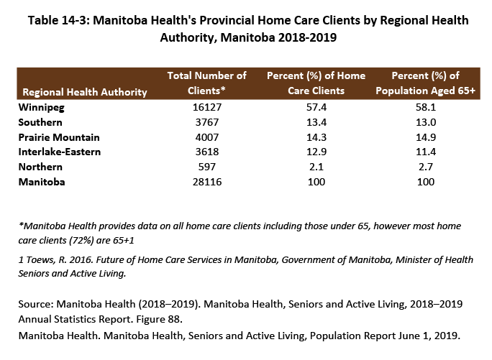

©2018 Centre on Aging, University of Manitoba
Notes:
How to cite this graphic:
Table 14-3: Manitoba Health's Provincial Home Care Clients by Regional Health Authority, Manitoba 2015-2016. Reprinted from Facts on Aging: Health care and community services, by the Centre on Aging, retrieved from http://www.umanitoba.ca/aging
Copyright 2018 by the Centre on Aging, University of Manitoba.

