Slide 1
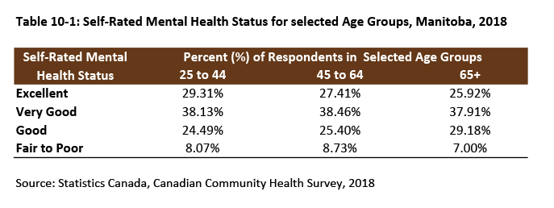
©2020 Centre on Aging, University of Manitoba
Notes:
How to cite this graphic:
Table 10-1: Self-Rated Mental Health Status for Selected Age Groups, Manitoba, 2018. Reprinted from Facts on Aging: Mental health status, by the Centre on Aging, retrieved from http://www.umanitoba.ca/aging
Copyright 2020 by the Centre on Aging, University of Manitoba.

