Slide 1
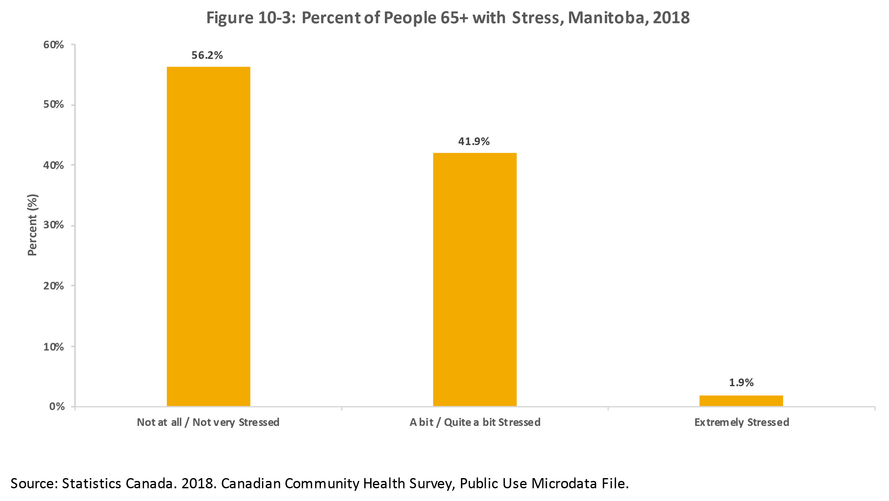
©2020 Centre on Aging, University of Manitoba
Notes:
How to cite this graphic:
Figure 10-3: Percent of People 65+ with Stress, Manitoba, 2015. Reprinted from Facts on Aging: Mental health status, by the Centre on Aging, retrieved from http://www.umanitoba.ca/aging
Copyright 2018 by the Centre on Aging, University of Manitoba.

