Slide 1
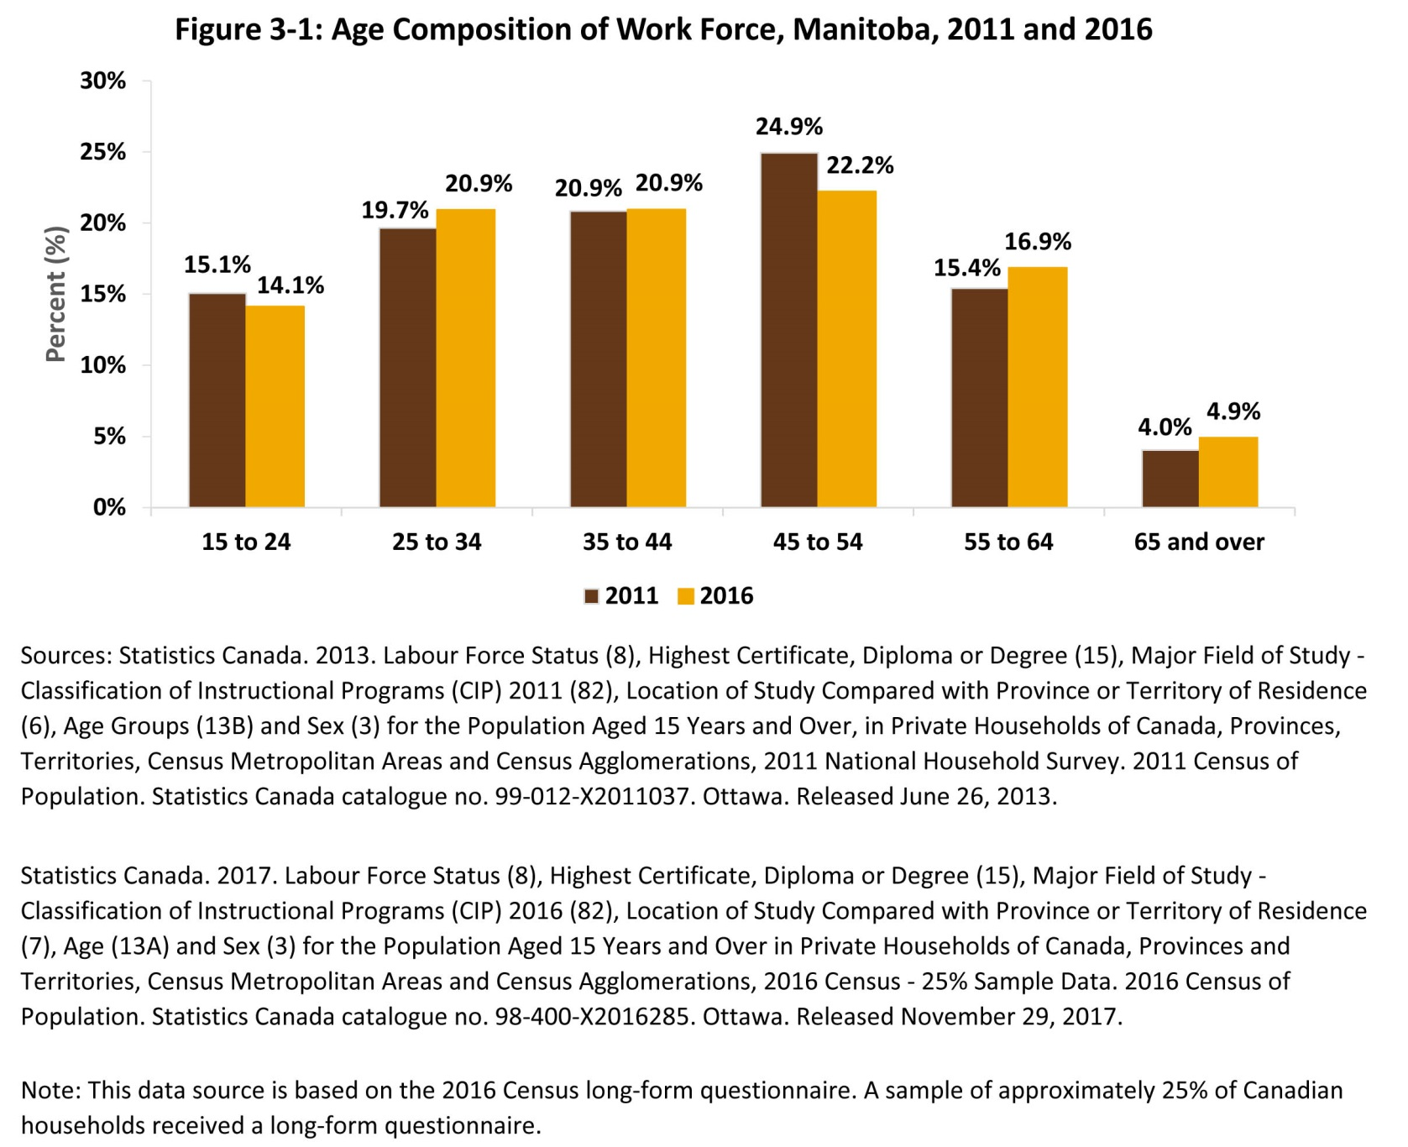
©2018 Centre on Aging, University of Manitoba
Notes:
How to cite this graphic:
Figure 3-1: Age Composition of Work Force, Manitoba, 2011 and 2016 . Reprinted from Facts on Aging: The older worker, by the Centre on Aging, retrieved from http://www.umanitoba.ca/aging
Copyright 2018 by the Centre on Aging, University of Manitoba.

