Slide 1
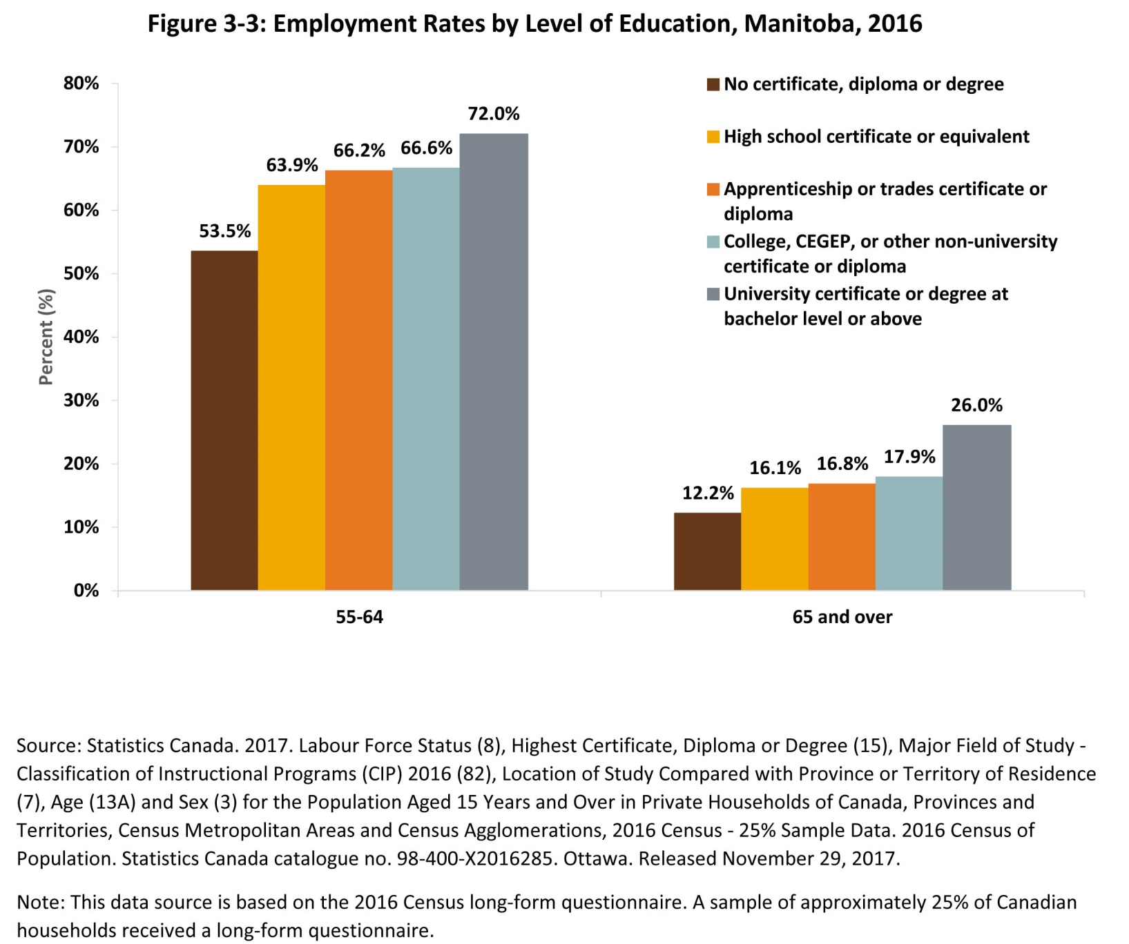
©2018 Centre on Aging, University of Manitoba
Notes:
How to cite this graphic:
Figure 3-3: Employment Rates by Level of Education, Manitoba, 2016. Reprinted from Facts on Aging: The older worker, by the Centre on Aging, retrieved from http://www.umanitoba.ca/aging
Copyright 2018 by the Centre on Aging, University of Manitoba.

