Slide 1
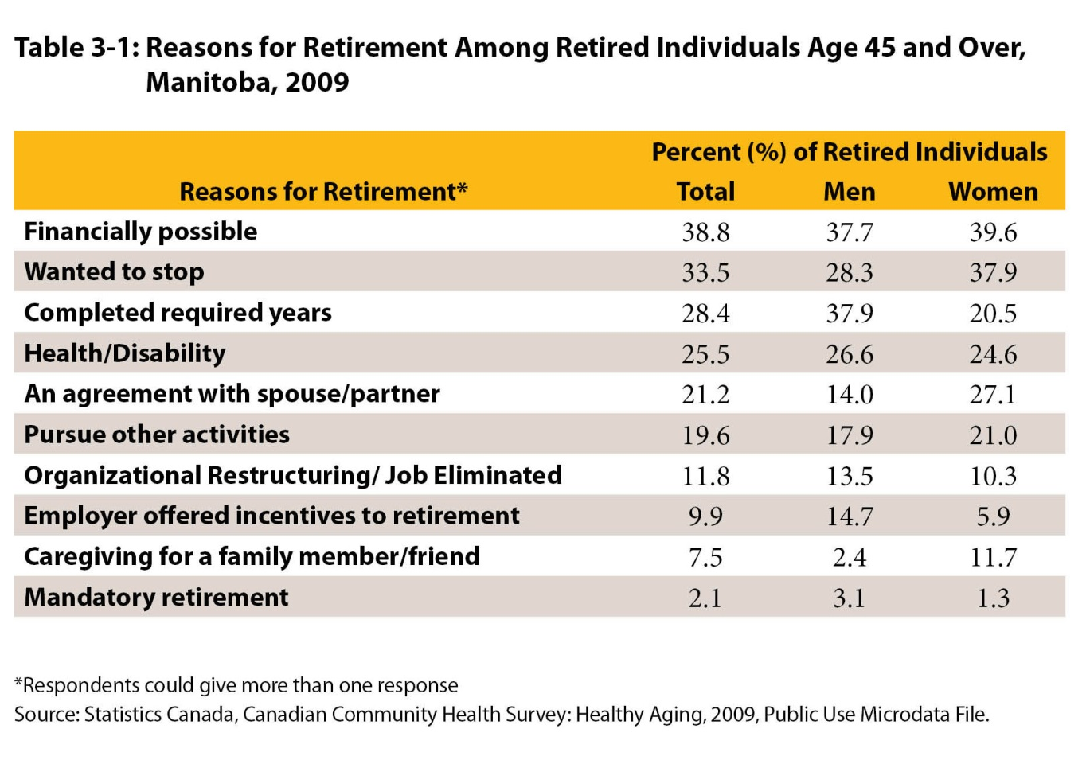
Notes:
How to cite this graphic:
Table 3-1: Reasons for Retirement Among Retired Individuals Age 45 and Over, Manitoba, 2009. Reprinted from Facts on Aging: The older worker, by the Centre on Aging, retrieved from http://www.umanitoba.ca/aging
Copyright 2017 by the Centre on Aging, University of Manitoba.

