Slide 1
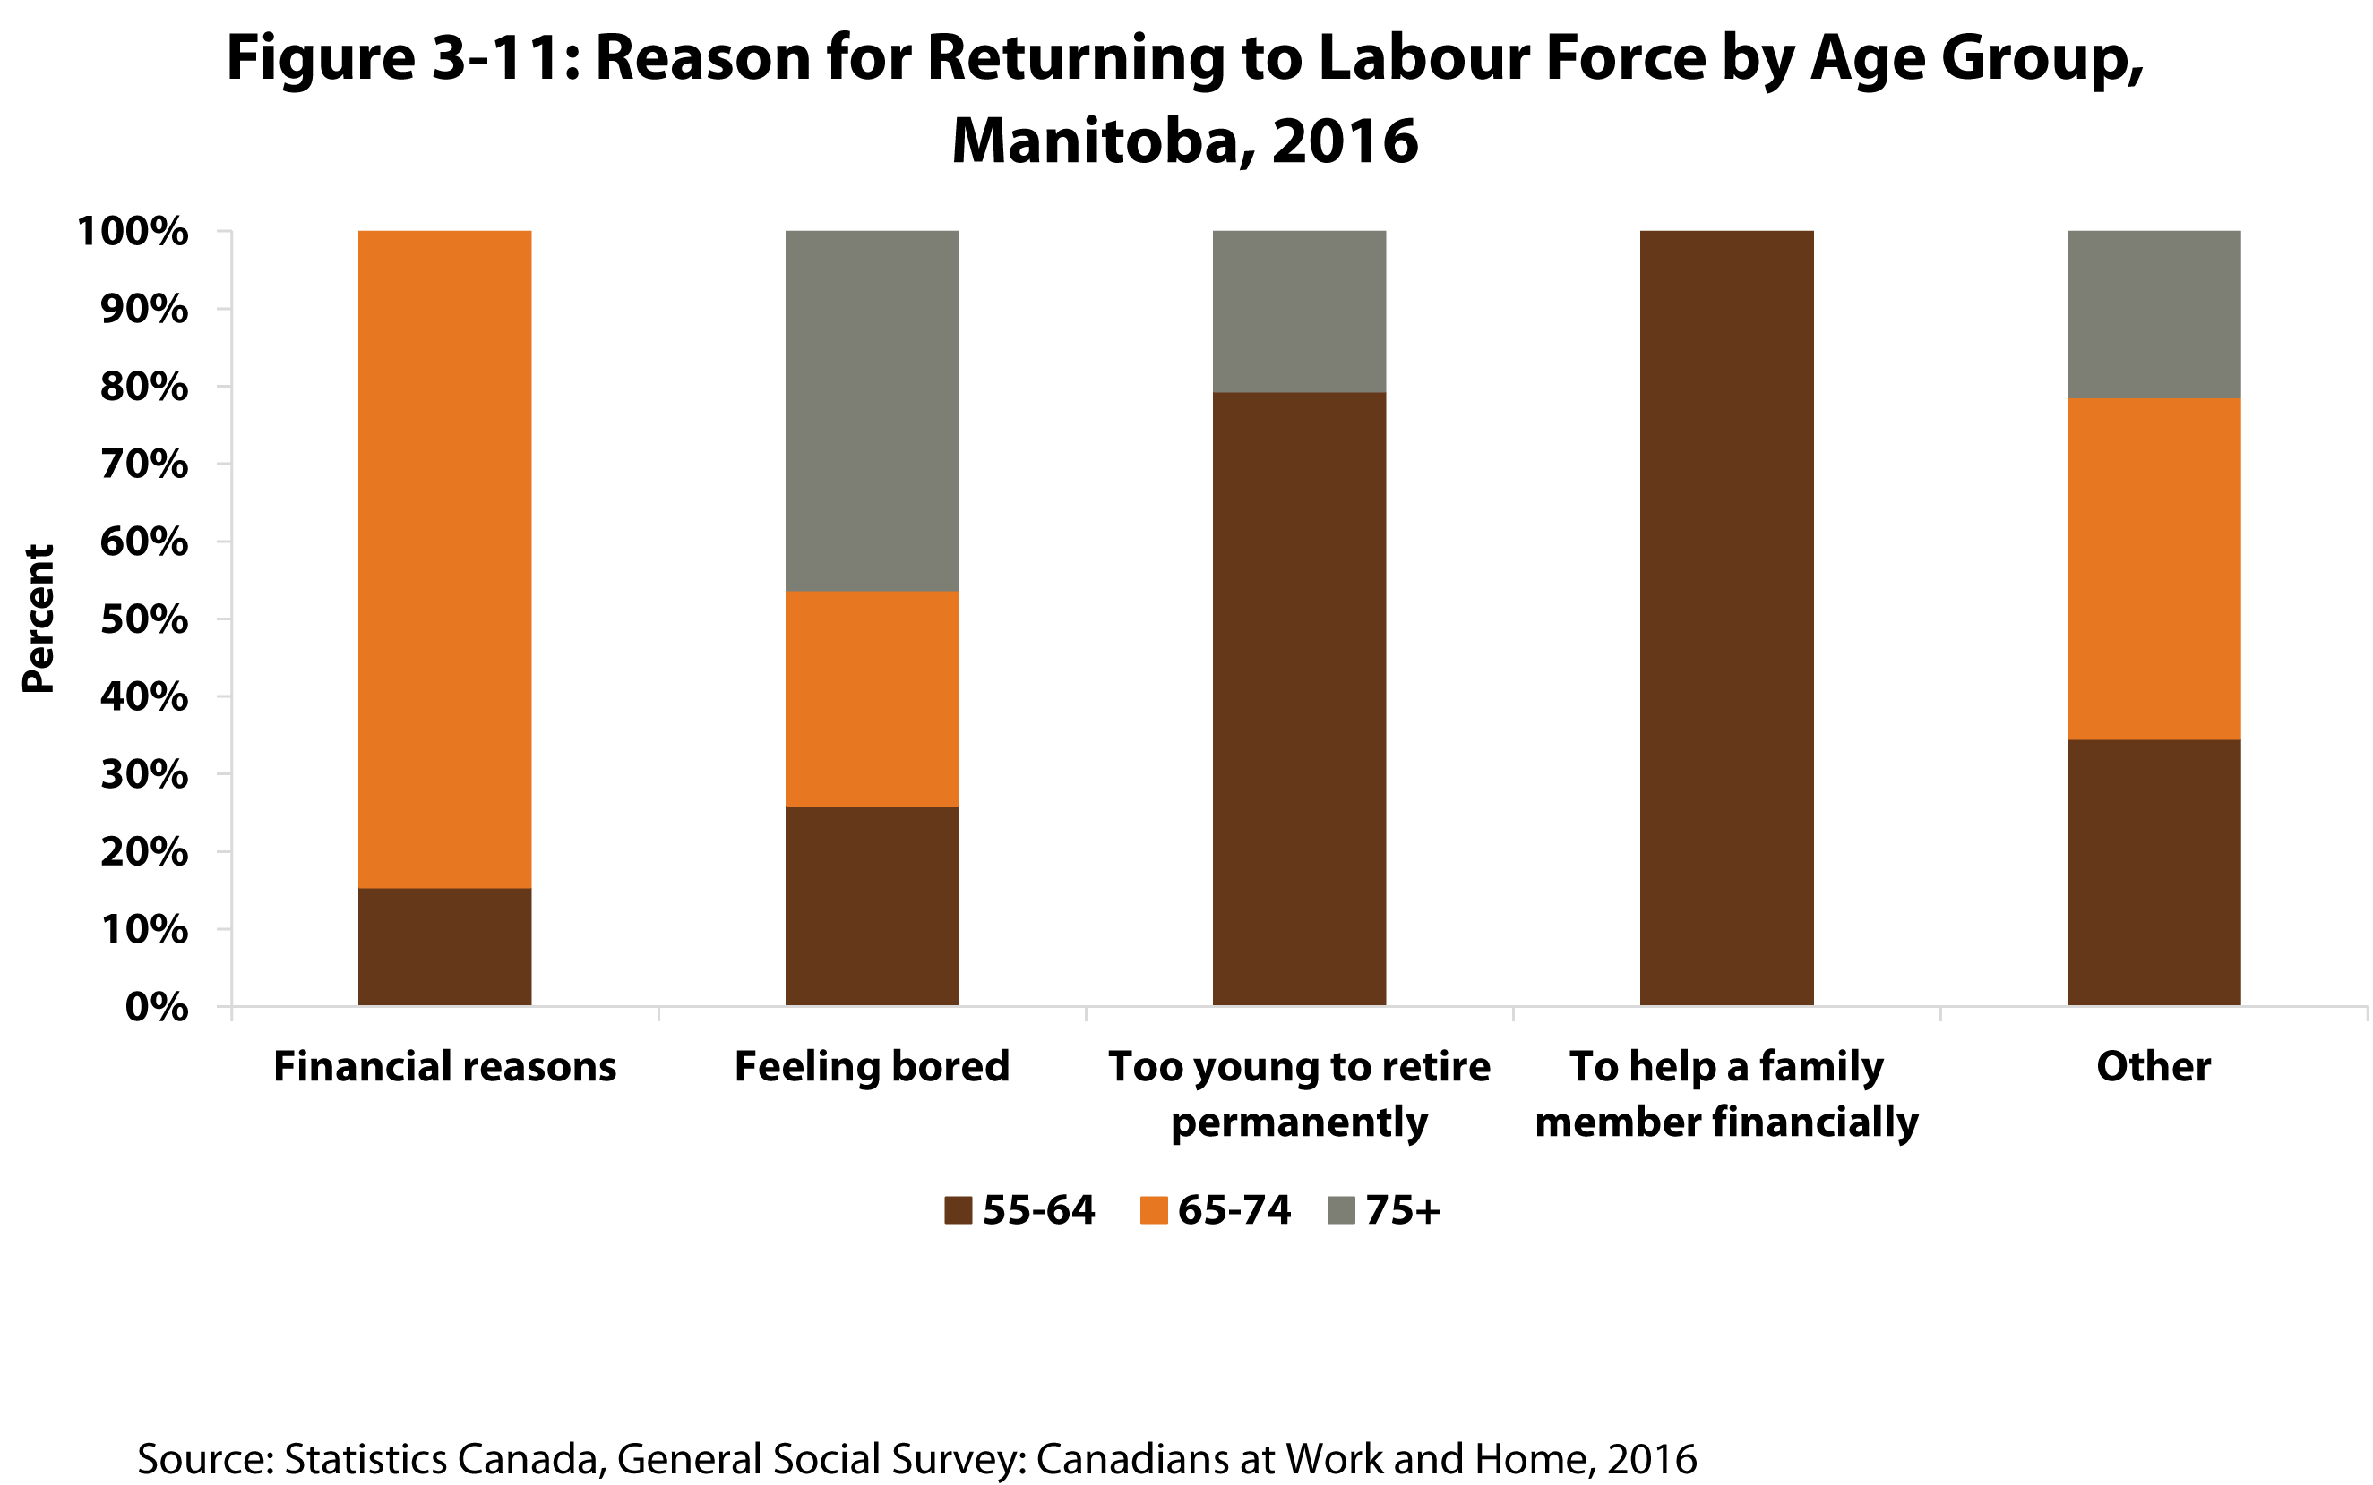

©2019 Centre on Aging, University of Manitoba
Notes:
How to cite this graphic:
Figure 3-11: Reason for Returning to Labour Force by Age Group, Manitoba, 2016. Reprinted from Facts on Aging: The older worker, by the Centre on Aging, retrieved from http://www.umanitoba.ca/aging
Copyright 2019 by the Centre on Aging, University of Manitoba.

