Slide 1
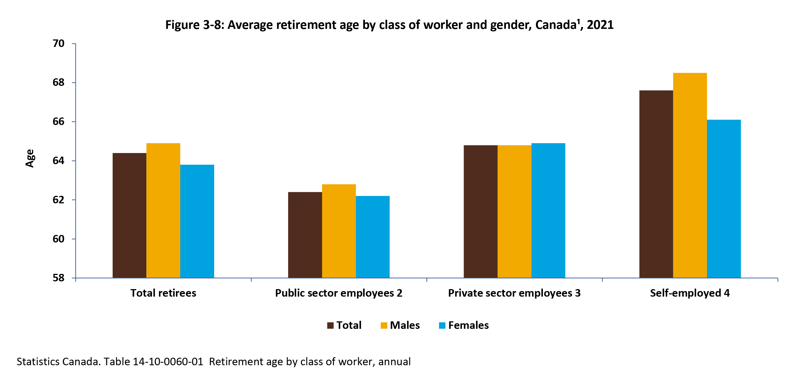
©2022 Centre on Aging, University of Manitoba
Notes:
How to cite this graphic:
Figure 3-8: Average retirement age by class of worker and gender, Canada¹, 2021. Reprinted from Facts on Aging: The older worker, by the Centre on Aging, retrieved from http://www.umanitoba.ca/aging
Copyright 2022 by the Centre on Aging, University of Manitoba.

