Slide 1
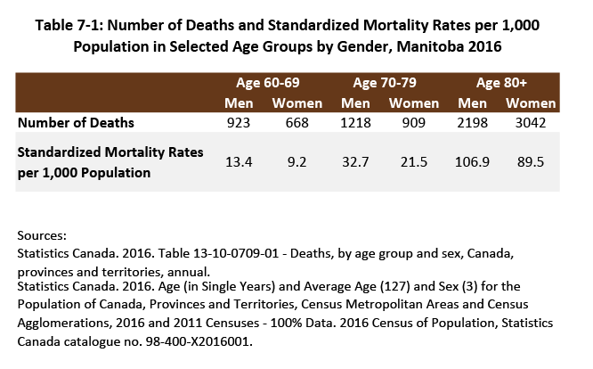

©2018 Centre on Aging, University of Manitoba
Notes:
How to cite this graphic:
Table 7-1: Number of Deaths and Standardized Mortality Rates per 1,000 Population in Selected Age Groups by Gender, Manitoba 2016. Reprinted from Facts on Aging: Physical health status, by the Centre on Aging, retrieved from http://www.umanitoba.ca/aging
Copyright 2018 by the Centre on Aging, University of Manitoba.

