Slide 1
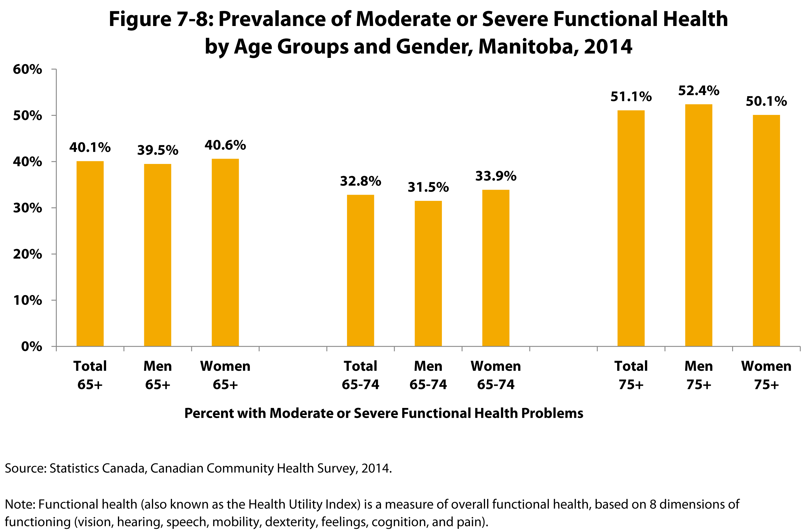
©2017 Centre on Aging, University of Manitoba
Notes:
How to cite this graphic:
Figure 7-8: Prevalance of Moderate or Severe Functional Health by Age Groups and Gender, Manitoba, 2014. Reprinted from Facts on Aging: Physical Health Status, by the Centre on Aging, retrieved from http://www.umanitoba.ca/aging
Copyright 2017 by the Centre on Aging, University of Manitoba.

