Slide 1
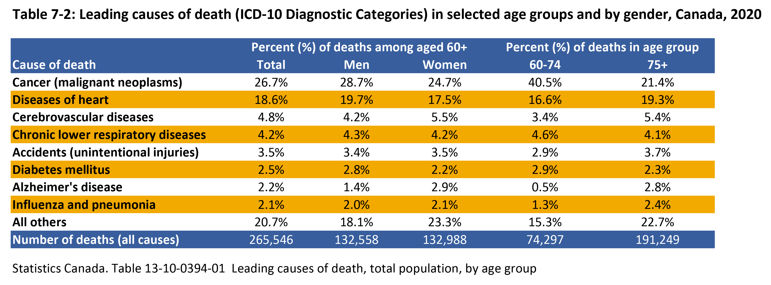

©2022 Centre on Aging, University of Manitoba
Notes:
How to cite this graphic:
Table 7-2: Leading causes of death (ICD-10 diagnostic categories) in selected age groups and by gender, Canada, 2020. Reprinted from Facts on Aging: Physical health status, by the Centre on Aging, retrieved from http://www.umanitoba.ca/aging
Copyright 2022 by the Centre on Aging, University of Manitoba.

