Slide 1
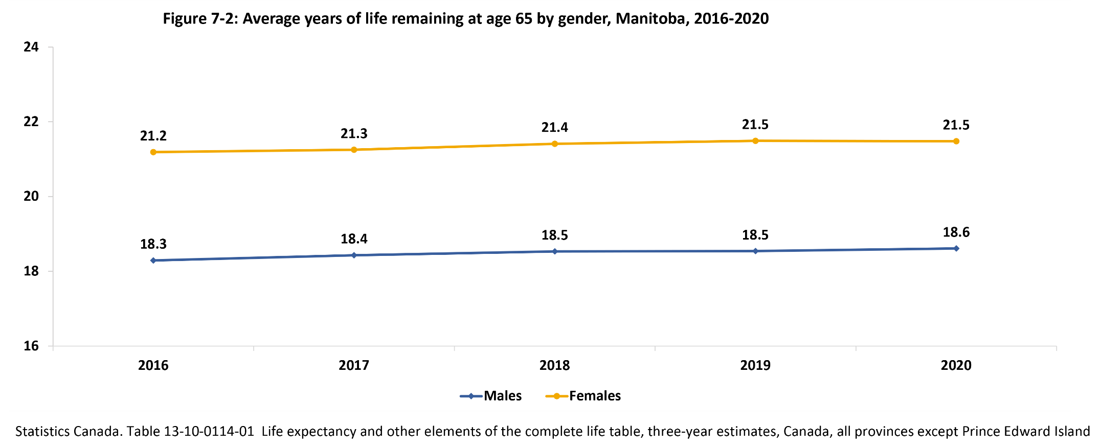
©2022 Centre on Aging, University of Manitoba
Notes:
How to cite this graphic:
Figure 7-2: Average years of life remaining at age 65 by gender, Manitoba, 2016-2020. Reprinted from Facts on Aging: Physical health status, by the Centre on Aging, retrieved from http://www.umanitoba.ca/aging
Copyright 2022 by the Centre on Aging, University of Manitoba.

