Slide 1
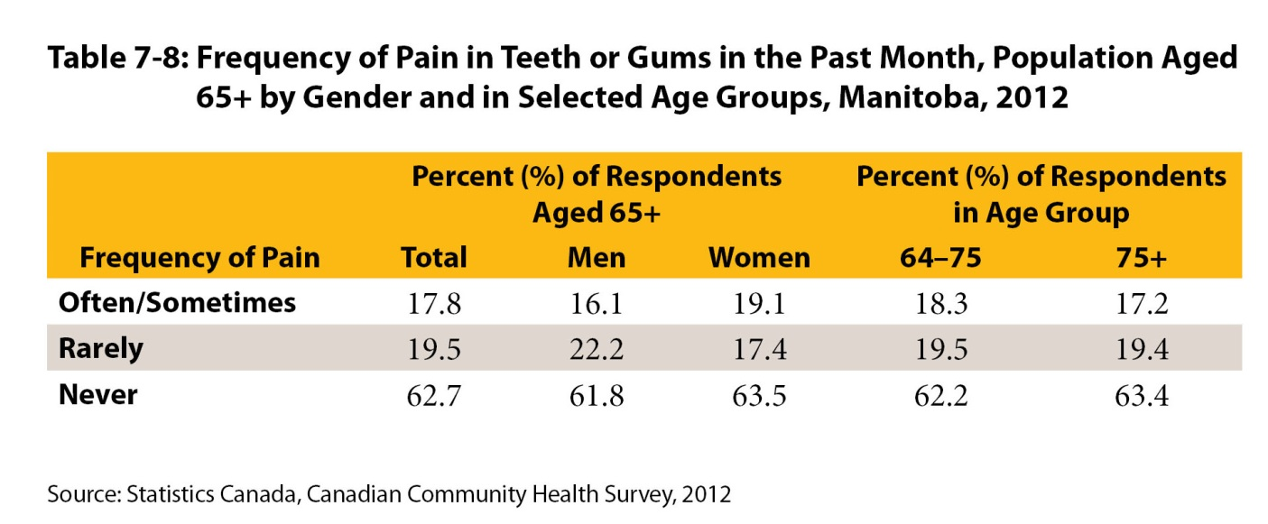
©2017 Centre on Aging, University of Manitoba
Notes:
How to cite this graphic:
Table 7-8: Frequency of Pain in Teeth or Gums in the Past Month, Population Aged 65+ by Gender and in Selected Age Groups, Manitoba, 2012. Reprinted from Facts on Aging: Physical Health Status, by the Centre on Aging, retrieved from http://www.umanitoba.ca/aging
Copyright 2017 by the Centre on Aging, University of Manitoba.

