Slide 1
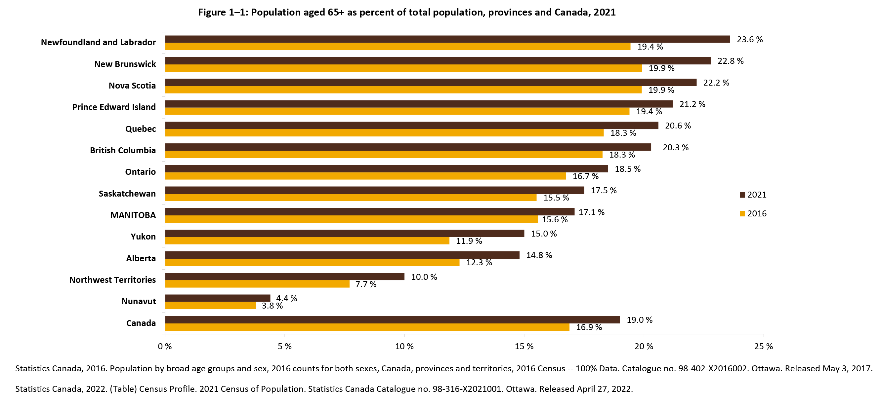
©2022 Centre on Aging, University of Manitoba
Notes:
How to cite this graphic:
Figure 1-1. Figure of population aged 65+ as percent of total population, provinces and Canada, 2021. Reprinted from Facts on Aging: Demographics, by the Centre on Aging, retrieved from http://www.umanitoba.ca/aging
Copyright 2022 by the Centre on Aging, University of Manitoba.

