Slide 1
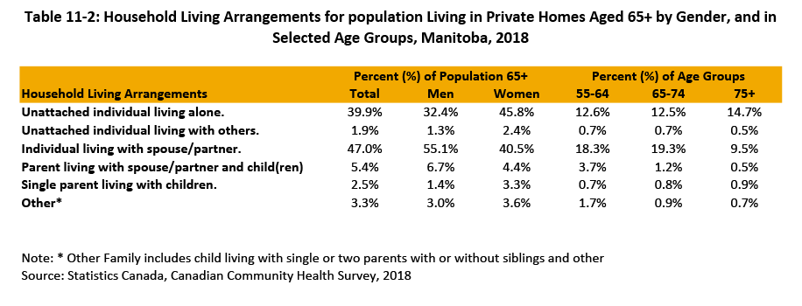

©2020 Centre on Aging, University of Manitoba
Notes:
How to cite this graphic:
Table 11-2: Household Living Arrangements for population Living in Private Homes Aged 65+ by Gender, and in Selected Age Groups, Manitoba, 2018. Reprinted from Facts on Aging: The older worker, by the Centre on Aging, retrieved from http://www.umanitoba.ca/aging
Copyright 2020 by the Centre on Aging, University of Manitoba.

