Slide 1
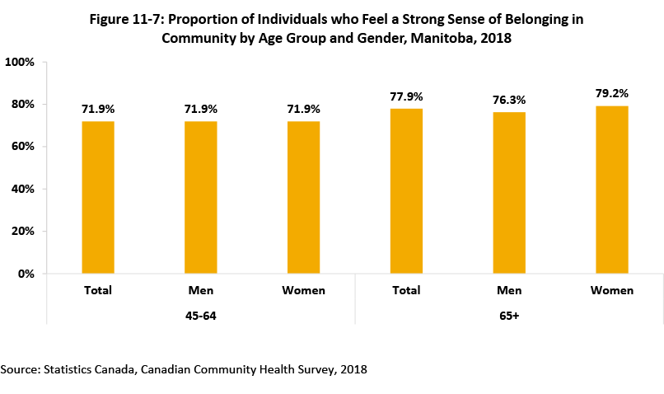

©2020 Centre on Aging, University of Manitoba
Notes:
How to cite this graphic:
Figure 11-7: Proportion of Individuals who Feel a Strong Sense of Belonging in Community by Age Group and Gender, 2018. Reprinted from Facts on Aging: The older worker, by the Centre on Aging, retrieved from http://www.umanitoba.ca/aging
Copyright 2020 by the Centre on Aging, University of Manitoba.

