Slide 1
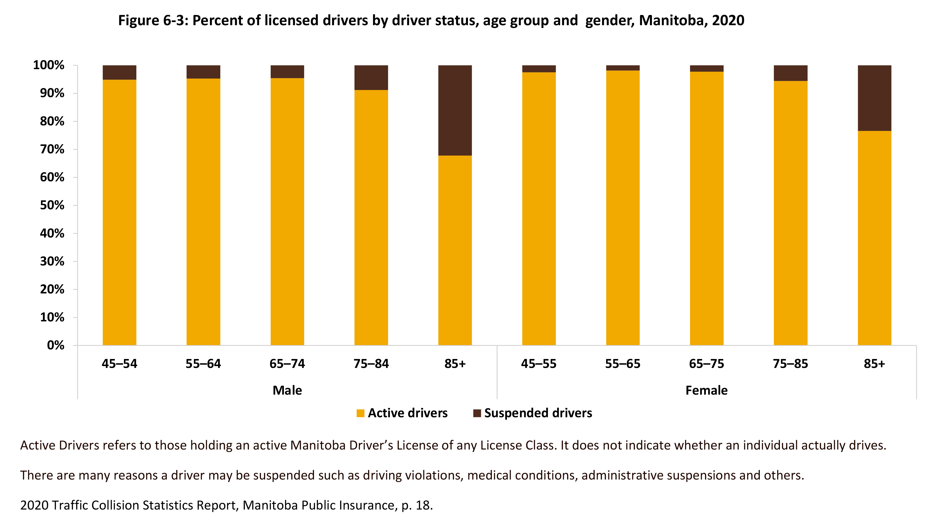
©2022 Centre on Aging, University of Manitoba
Notes:
How to cite this graphic:
Figure 6-3: Percent of licensed drivers by driver status, age group and gender, Manitoba, 2020. Reprinted from Facts on Aging: Transportation, by the Centre on Aging, retrieved from http://www.umanitoba.ca/aging
Copyright 2022 by the Centre on Aging, University of Manitoba.

