Slide 1
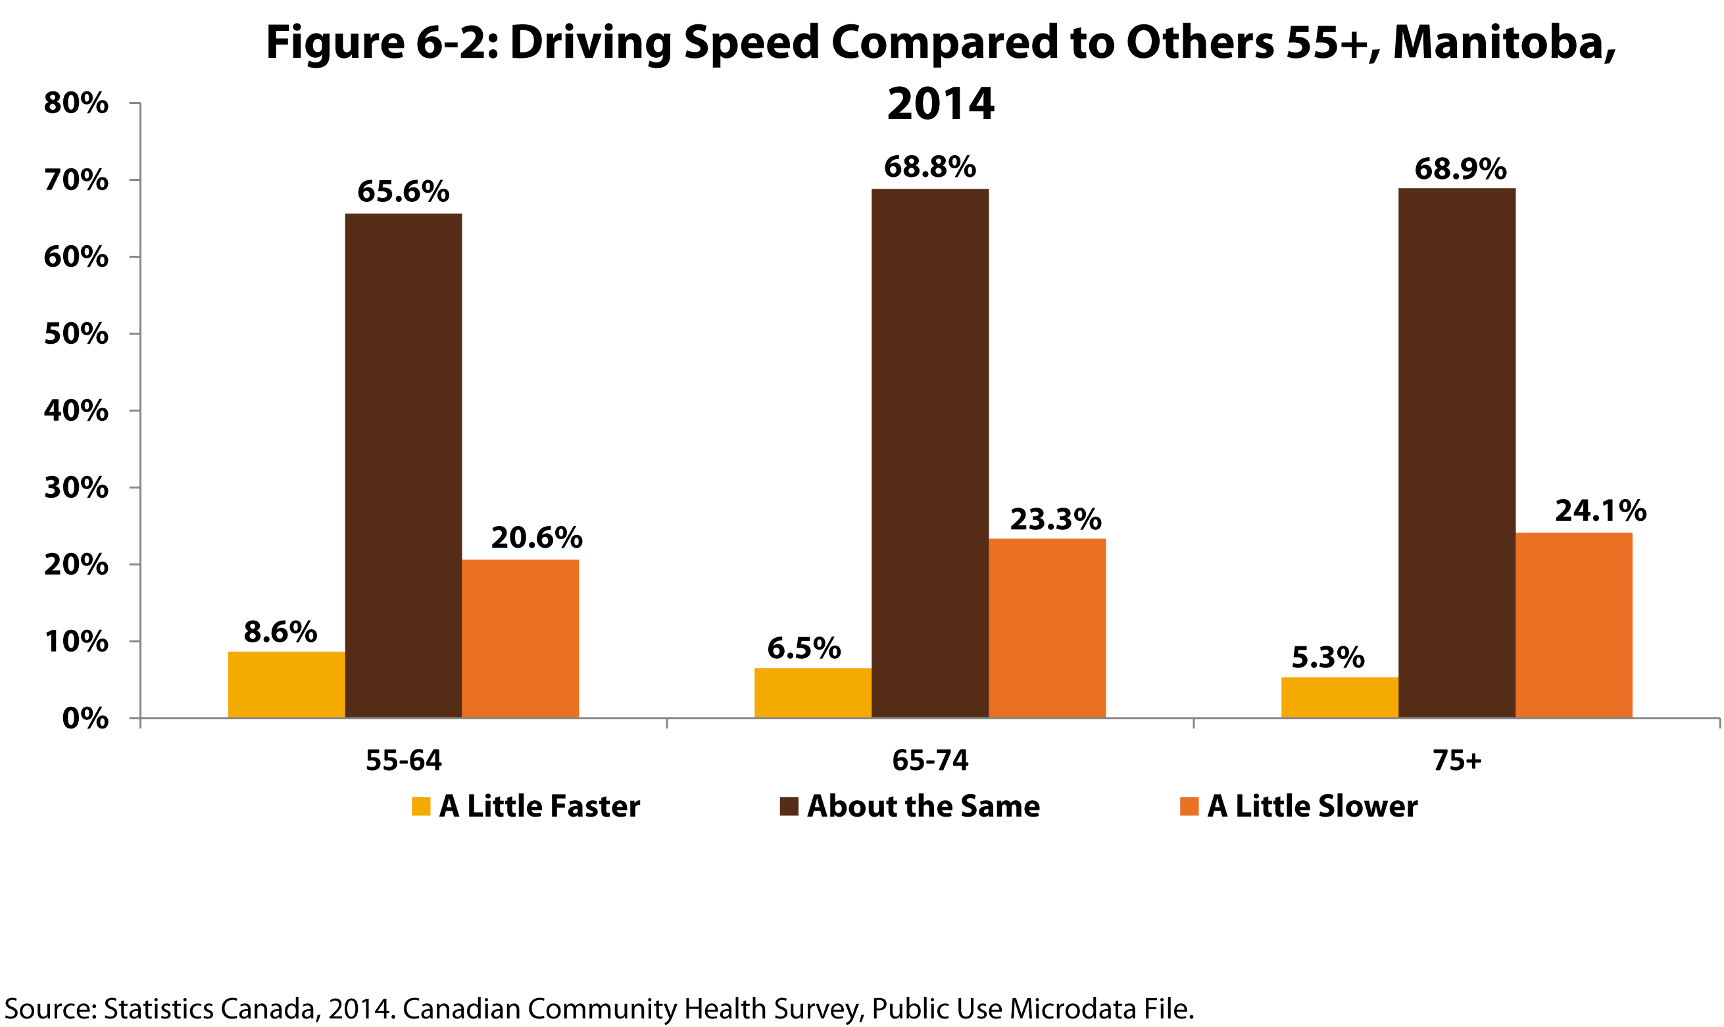
©2017 Centre on Aging, University of Manitoba
Notes:
How to cite this graphic:
Figure 6-2: Driving Speed Compared to Others 55+, Manitoba, 2014. Reprinted from Facts on Aging: Transportation, by the Centre on Aging, retrieved from http://www.umanitoba.ca/aging
Copyright 2017 by the Centre on Aging, University of Manitoba.

