Slide 1
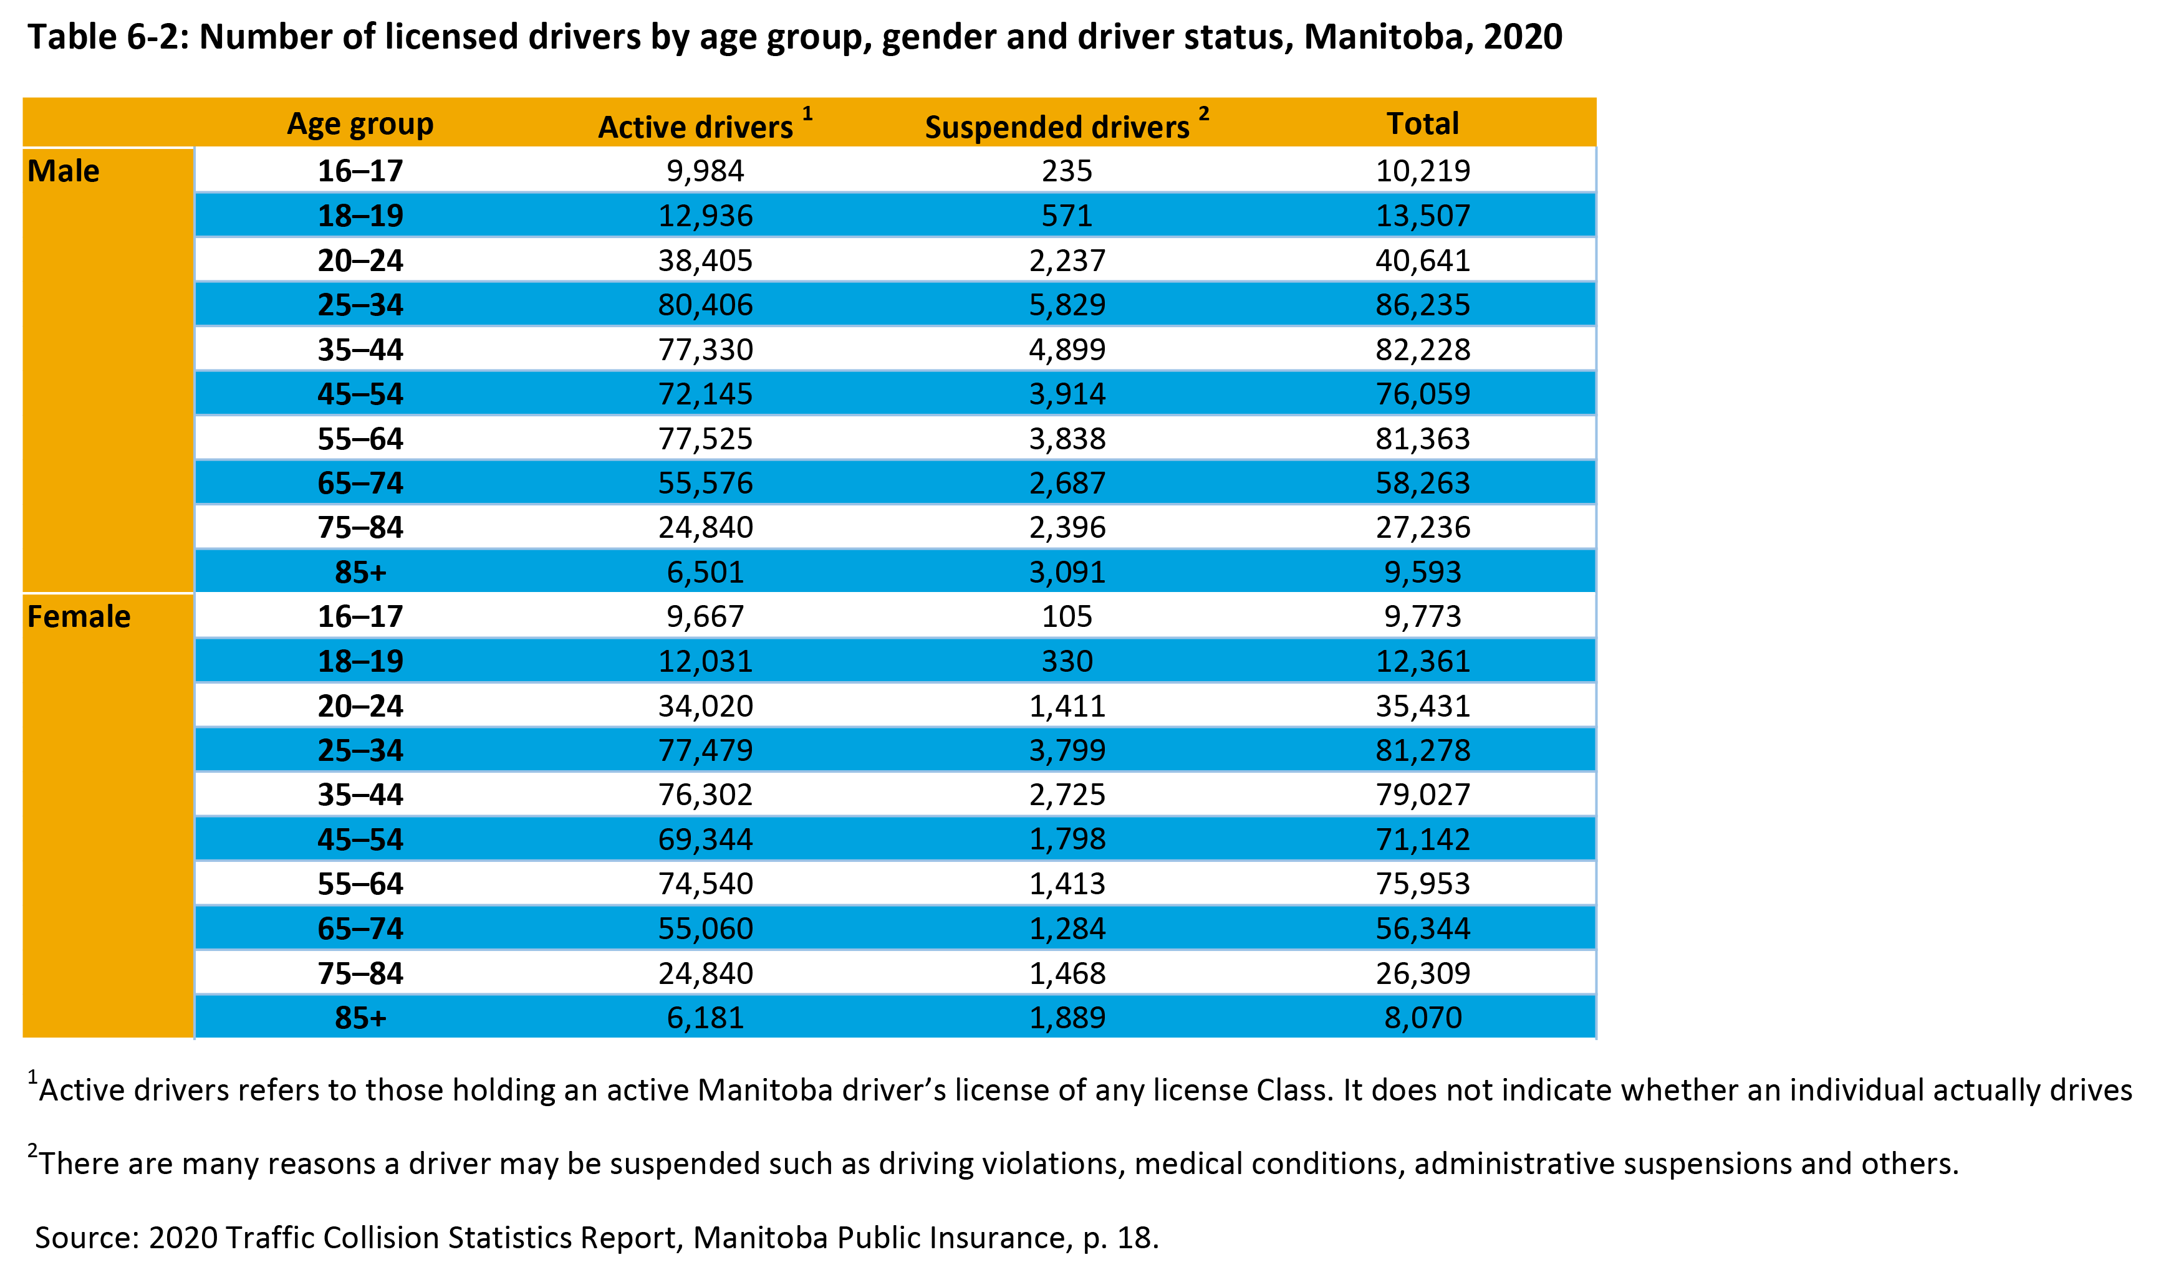
©2022 Centre on Aging, University of Manitoba
Notes:
How to cite this graphic:
Table 6-2: Number of licensed drivers by age group, gender and driver status, Manitoba, 2020. Reprinted from Facts on Aging: The older worker, by the Centre on Aging, retrieved from http://www.umanitoba.ca/aging
Copyright 2022 by the Centre on Aging, University of Manitoba.

