Slide 1
Undergraduate Research Showcase 2023 Information Session
Office of the Vice-President (Research & International)

Slide 2
Notes:
On a personal level, I am the descendent of settlers in the Red River Valley and acknowledge the devastating impacts of colonialism. I am committed to supporting reconciliation through continuous learning, becoming a better ally, and deepening my relationships with Indigenous Peoples.

Slide 3
Undergraduate Poster Competition
Agenda
About the event
Eligibility
Competition formats
Registration
Event Day
Post event
FAQs
Questions

Slide 4
Undergraduate Research Showcase
About
Event date: Oct 31/23
Showcases undergraduate students’ expertise and passion for research
NEW up to $6,500 $5,000 in cash prizes
NEW Two presentation formats: Poster and Oral
Five categories per format: Applied Sciences, Creative Works, Health Sciences, Social Sciences & Humanities, and Natural Sciences
$500 (1st), $250 (2nd) (for categories > 5 entries)

Slide 5
About (cont’d)
Meant to be centered around a ‘research experience’, i.e through the Undergraduate Research Award (URA), NSERC Award, Co-op experience, etc.
Includes students with Honor’s thesis program or similar thesis research, wherein the Honor’s student has a UM supervisor or similar.
Not as the result of a course project, literature search or special topics course.

Slide 6
Undergraduate Research Showcase
Eligibility
Is open to all students who:
Are enrolled at the UofM as an undergraduate student at the time the research was conducted.
Have a UM or UM-affiliated research supervisor
Are on track to obtain a UofM undergraduate degree
Students who graduated in spring 2023 are eligible to enter provided the research presented on the poster was completed while registered as an undergrad
Notes:
A UM Advisor is typically a Professor who supervised their research. Ie for the URAs.
The applicant may currently be a Master's Student, but the research would have had to be done and completed while as an undergrad in 2023.

Slide 7
Competition formats:
Oral presentation
Students will have a maximum of 3 minutes to explain/describe their research project in any means/media format of their choosing.
i.e Oral presentation, PowerPoint presentation, 3-D Demonstration, Video, etc.

Slide 8
Competition formats (cont’d):
Poster presentation
Students will set up a poster at an established time and will be provided with a 2-hr window of time in which the judging will be conducted.

Slide 9
Undergraduate Research Showcase
Registration
Complete online form by: October 13, 2023
Go to VPRIO webpage Undergraduate Research Showcase | Research | University of Manitoba (umanitoba.ca)

Slide 10
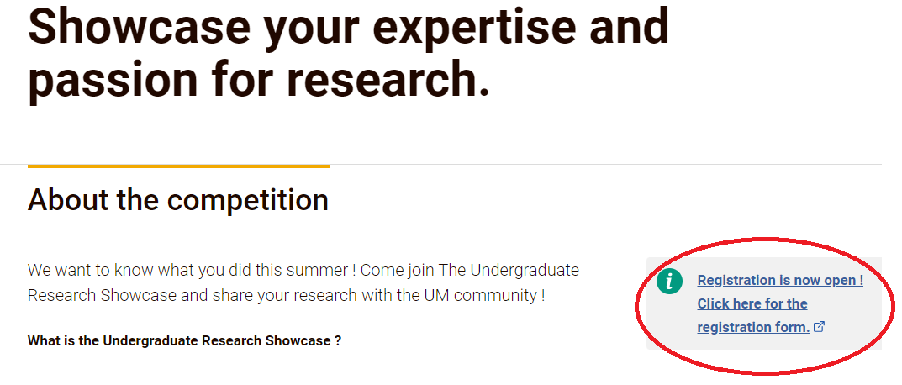

Slide 12
I’ve registered, now what?
Confirmation of registration from the Office of the VP (Research and International) (VPRIO) (approx. 3rd week of Oct)
If Oral format selected:
VPRIO will contact you requesting information on your presentation, and any media or A/V required.
VPRIO will provide details about time slot for presentation
Notes:
You will be assigned a 4'H X 8'W Poster Board on which to display your research, scholarly work or creative activity. Please note that you will need a 4"H X 11"W space in the upper right-hand corner for the poster board number identifying your project. Other than that, the space is yours.

Slide 13
I’ve registered, now what? (cont’d)
If Poster format selected:
VPRIO will contact you and confirm registration:
Provide details on poster set-up time
Provide details on judging window
Work on your poster
Poster board size: 8ft wide x 4ft tall
No restrictions on that is posted in that space. i.e Can be multiple sheets posted together, collage format, 1 large poster printed at CadLab, etc.
Notes:
You will be assigned a 4'H X 8'W Poster Board on which to display your research, scholarly work or creative activity. Please note that you will need a 4"H X 11"W space in the upper right-hand corner for the poster board number identifying your project. Other than that, the space is yours.

Slide 14
Poster Board

Slide 15
Event Day schedule
Poster format:
Arrive at the Multi-purpose room (2nd floor, University Centre) between 8:30am-10:00am to register and set up your poster. (the earlier, the better)
Push pins, tape provided.
You will be provided with a 2-hr judging window ahead of time.
3:00pm: close of judging, tallying of scores
4:00-4:30pm: Award presentation
4:30pm-5pm: Poster take-down (any remaining posters will be brought to reception in 410 Admin for collection by the student)
Notes:
You will need to check in at the registration desk upon arrival and we will give you directions as to where you are to set up your poster.
Any posters left in the MPR will be collected and brought to the main office of the VPRI in 110 Admin

Slide 16
Event Day schedule
Oral presentation format:
You will be provided with your presentation timeslot prior to the event, in which the judges will be present.
Arrive at the Multi-purpose room (2nd floor, University Centre) approximately 30 minutes prior to your presentation
You are not required to stay for the remainder of the event, but tables will be available for those who wish to stay and network.
3:00pm: close of judging, tallying of scores
4:00-4:30pm: Award presentation
Notes:
You will need to check in at the registration desk upon arrival and we will give you directions as to where you are to set up your poster.
Any posters left in the MPR will be collected and brought to the main office of the VPRI in 110 Admin

Slide 17
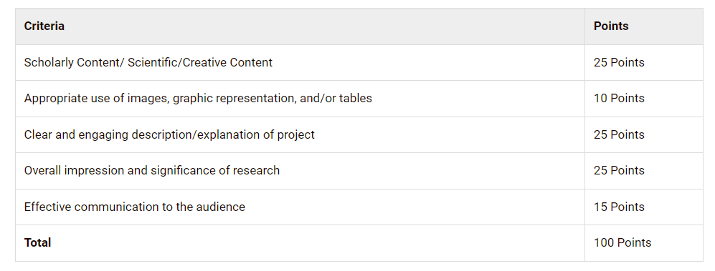
Undergraduate Poster Competition
Judging Criteria
Notes:
What is the difference between "qualitative" vs "quantitative" research? Qualitative methods primarily collect narrative data as part of a systematic investigation of social phenomena: the data produce information about how participants create meaning regarding a specific phenomenon of interest. If you’re not sure which best describes your methods check with your research advisor.

Slide 18
Post-event
Pick up your unclaimed poster in 410 Admin at reception
Winners will be contacted by email for some information in order to process the payment. (i.e SIN)
Certificates will be issued post-event.
Winners will have their name forwarded to the Registrar’s Office and will have this added to their co-curricular record.
Winners will be listed on the Poster Competition website

Slide 19
FAQ’s
I have an exam on the day of the event. Do I need to stay for the whole time during the competition? – No, but it is highly recommended you are present to present your poster.
I did a project this summer with a company where I worked. Could I present the research work I did with them at this competition? – only if you have a UM-affiliated research supervisor, i.e St. Boniface Hospital.
Am I required to speak briefly about my poster? - Yes
Will I be evaluated based on my ability to communicate my research and findings or are the evaluations based on the content of my poster? – Yes- see judging criteria
Will I be given a set appointment time to present the highlights of my poster to the judges? - Yes

Slide 20
FAQ’s
Could I submit a poster for a project that isn't completed yet? Yes
This summer I participated in a project with many people working on it. Should my poster demonstrate the entirety of the project or just my contribution as a research assistant?
Preferably, you should be the first author of the research on the poster. A disclaimer is highly recommended. You need to be able to identify your role in the context of the larger project. Also, you must contact the others involved for their permission should you present the entirety of the project.
My research partner and I were thinking of submitting our poster in the competition. Can we submit one poster under our names since we are both authors on it? - No
Notes:
Re: question 1: We don’t want to discourage you, so if you are comfortable entering the competition with uncompleted work, we will accept the poster.
Re: question 2: As long as you are currently enrolled as an Undergraduate student and you have a University of Manitoba advisor, we will accept the poster.

Slide 21
FAQ’s
How do I know which category my poster will fall under? - Please ask your research Advisor
When do I set up my poster? - 8:30am-10:00 am on Oct 31/23
Is there is a way I could arrange to drop off my poster prior to the event to be set up and displayed for me? - No
Where can I have my poster printed [on campus]? – CADLab for large posters, UMSU for letter-size printing
Can I bring a Laptop or Tablet to play media? - No
What is the deadline for registrations? - Fri, Oct 13/23
Other questions? Refer to the website or send an email to poster_competition@umanitoba.ca

Slide 22
Useful Resources
Tips for making a better research poster *
https://www.youtube.com/watch?v=AwMFhyH7_5g
* AJE - American Journal Experts

Slide 23
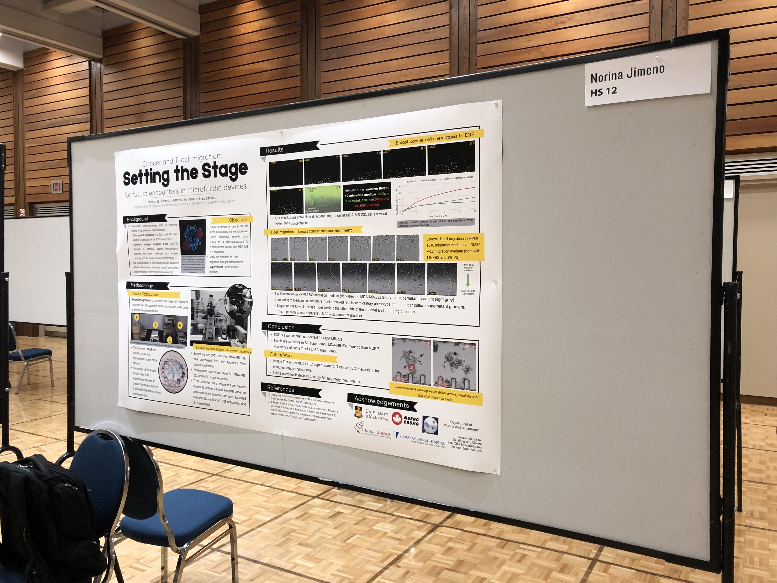
Examples of Posters

Slide 24
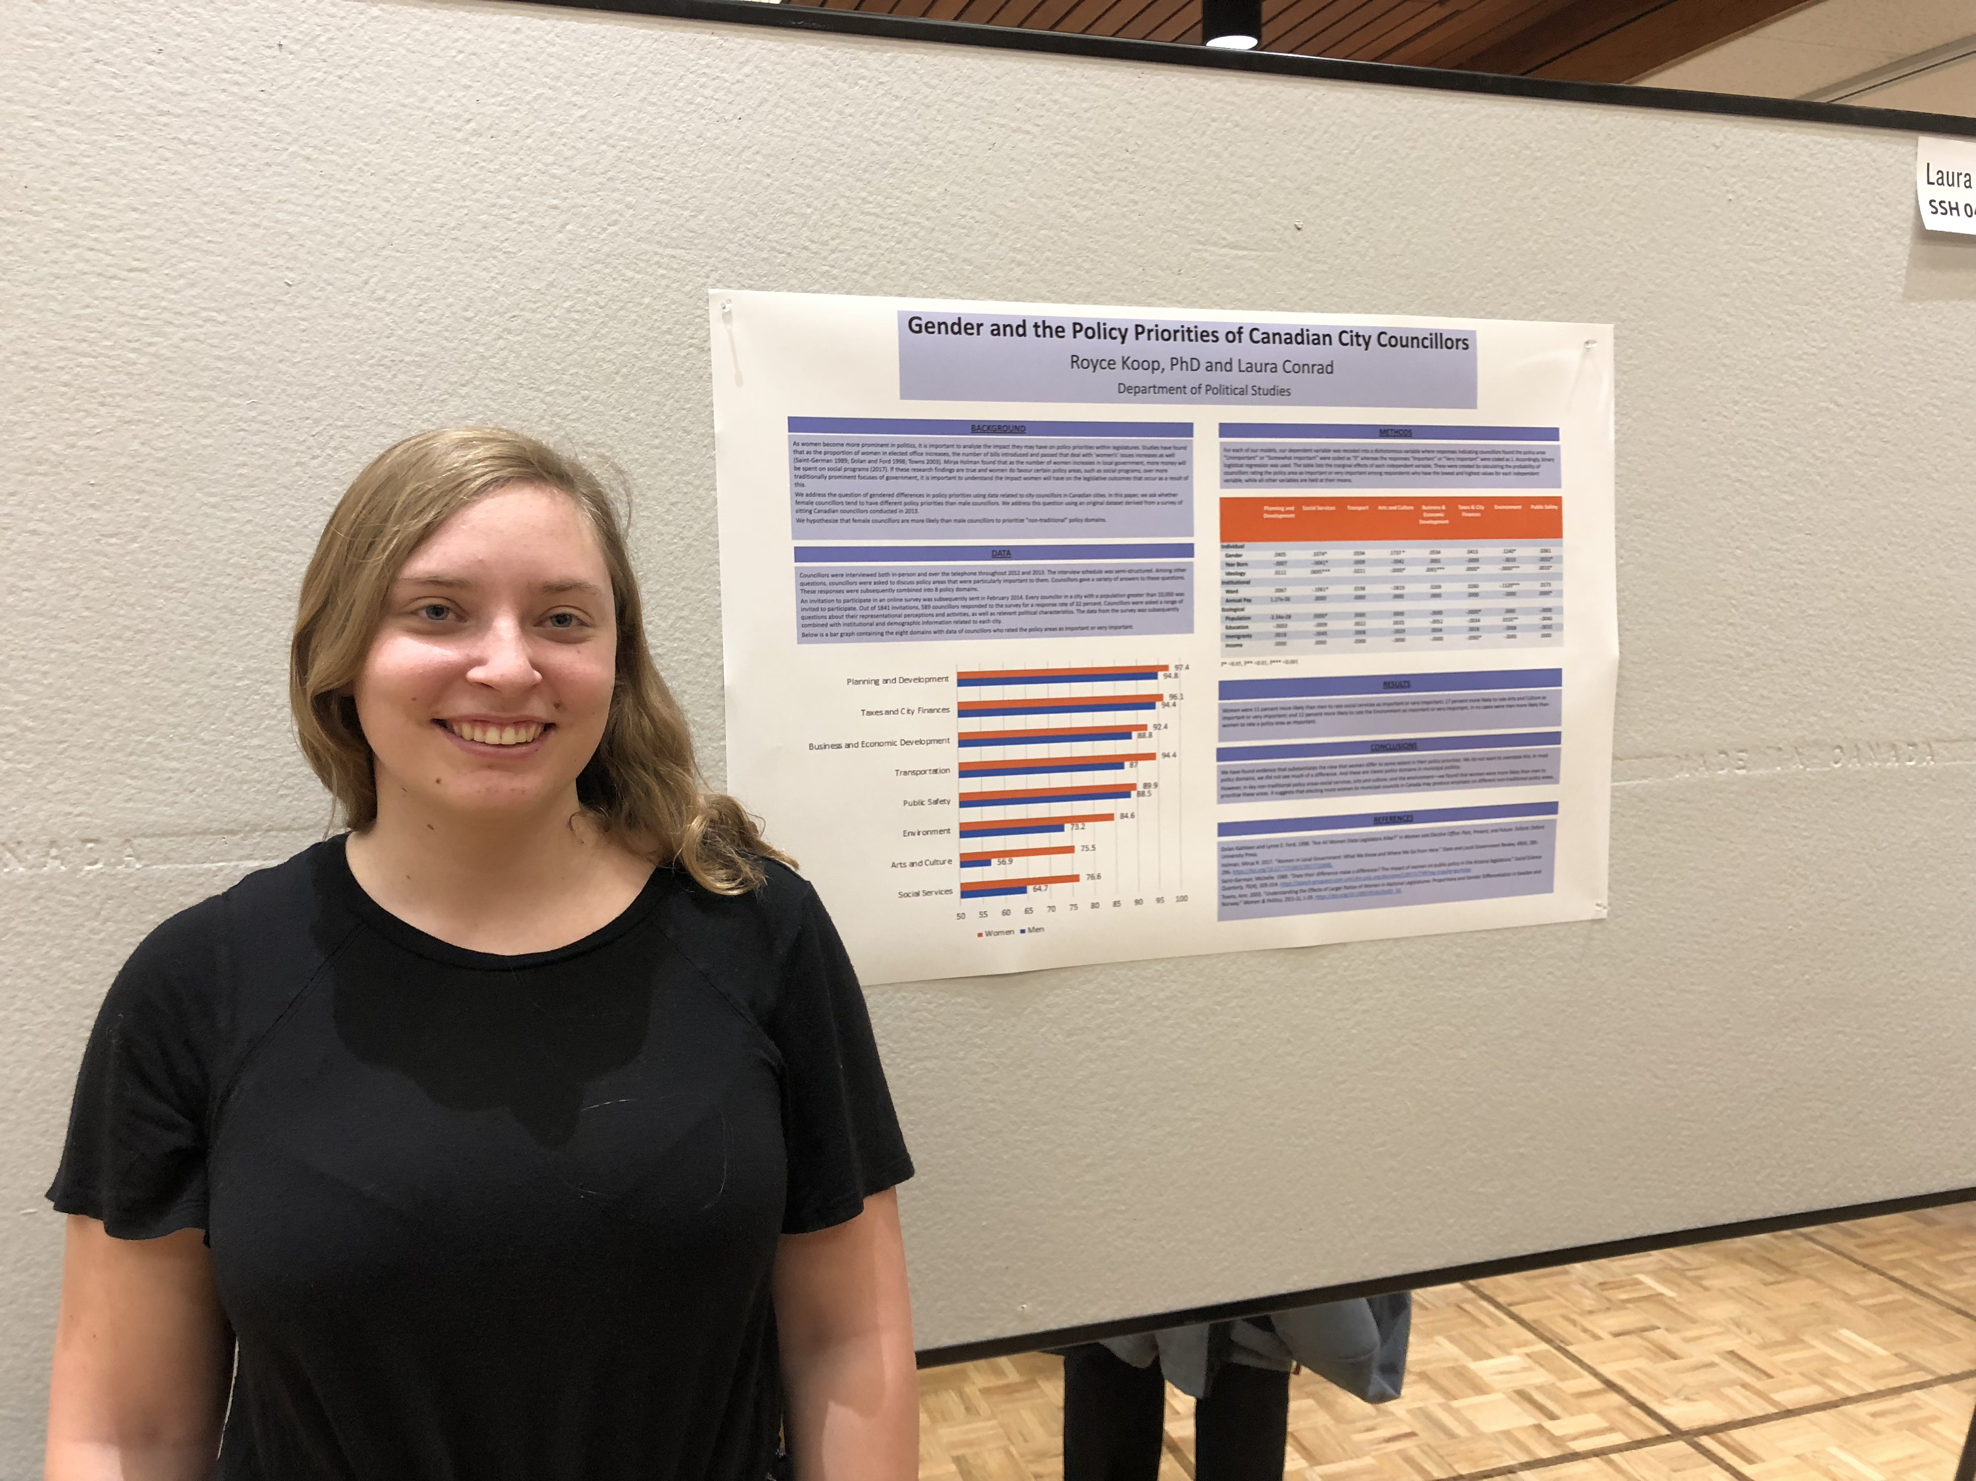
Examples of Posters

Slide 25
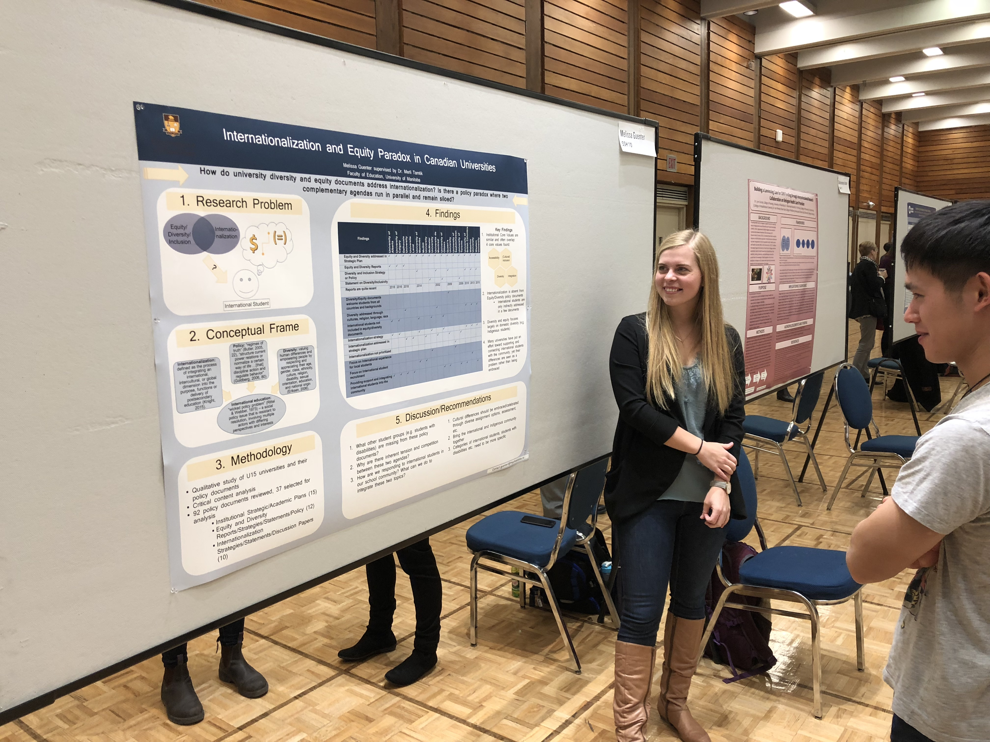
Examples of Posters

Slide 26
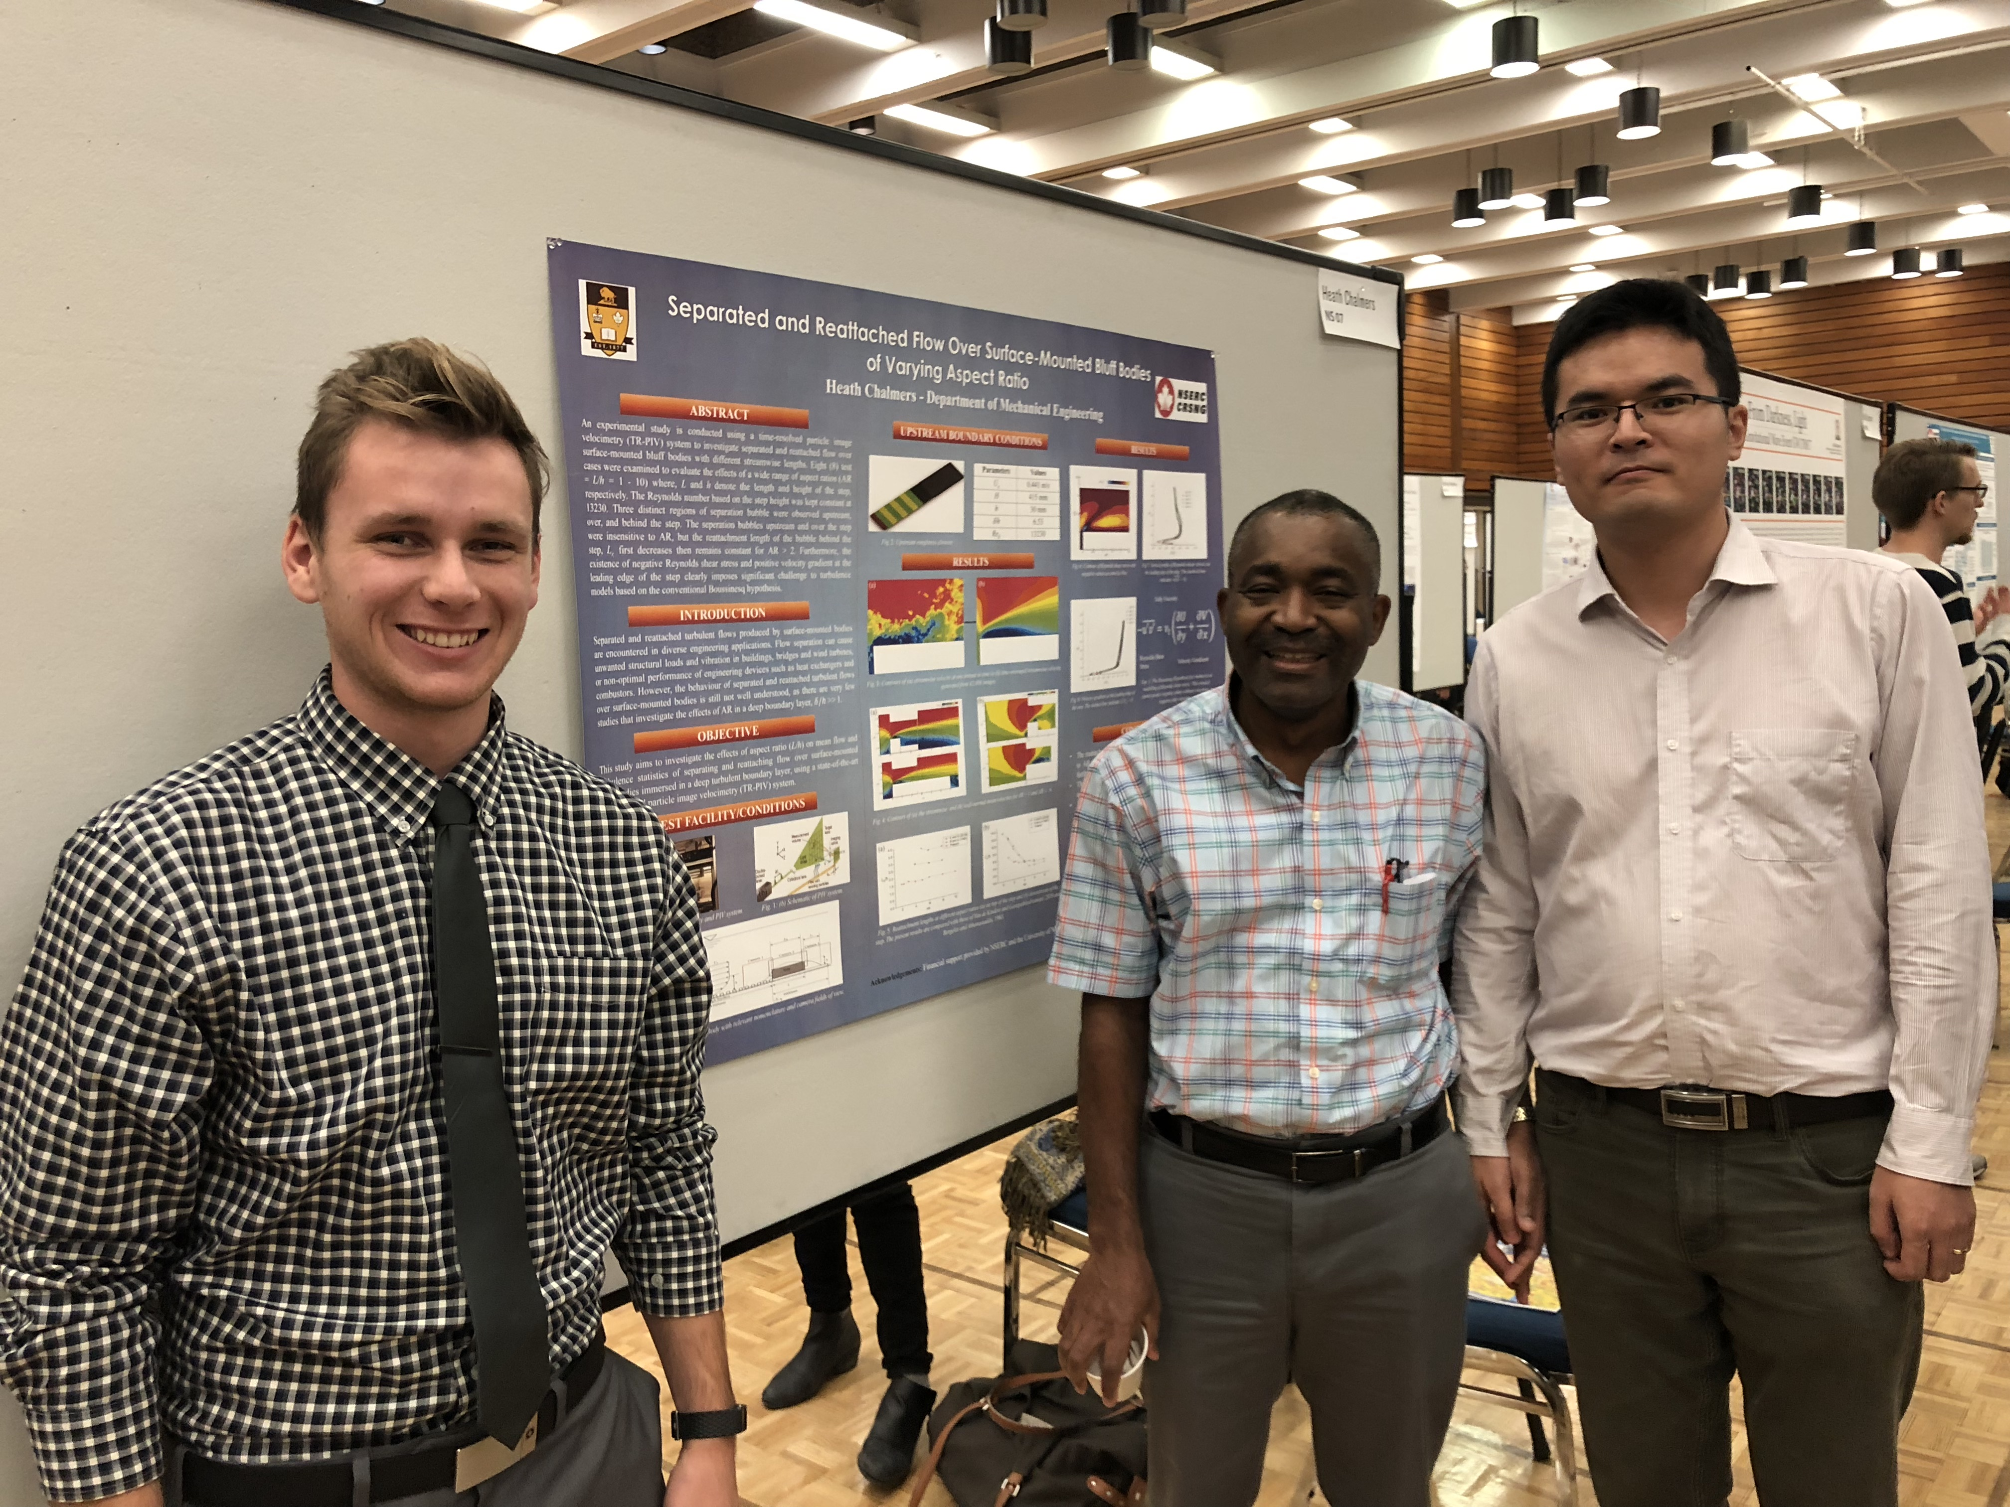
Examples of Posters

Slide 27
Examples of Posters

Slide 28
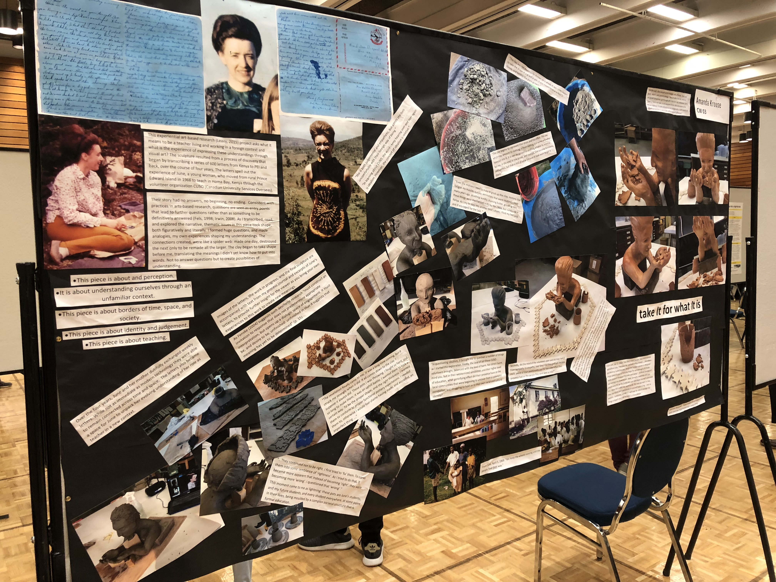
Examples of Posters

Slide 29
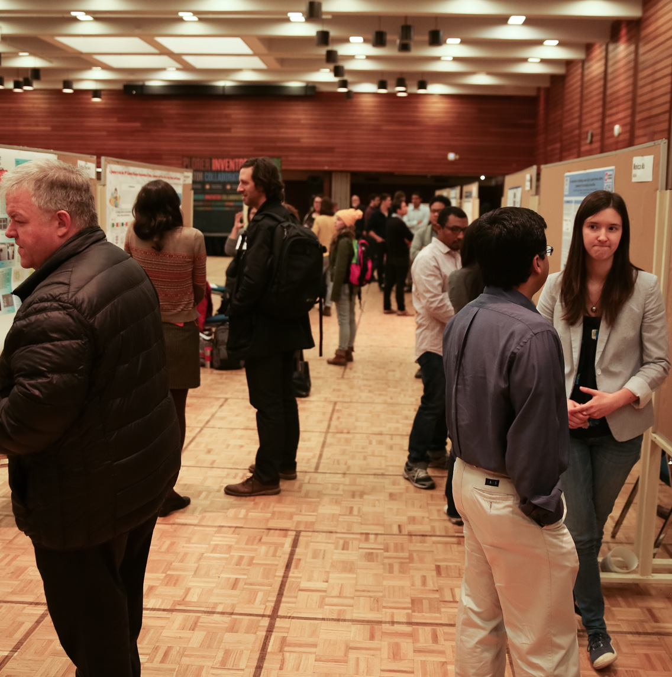
Questions?

