Slide 1
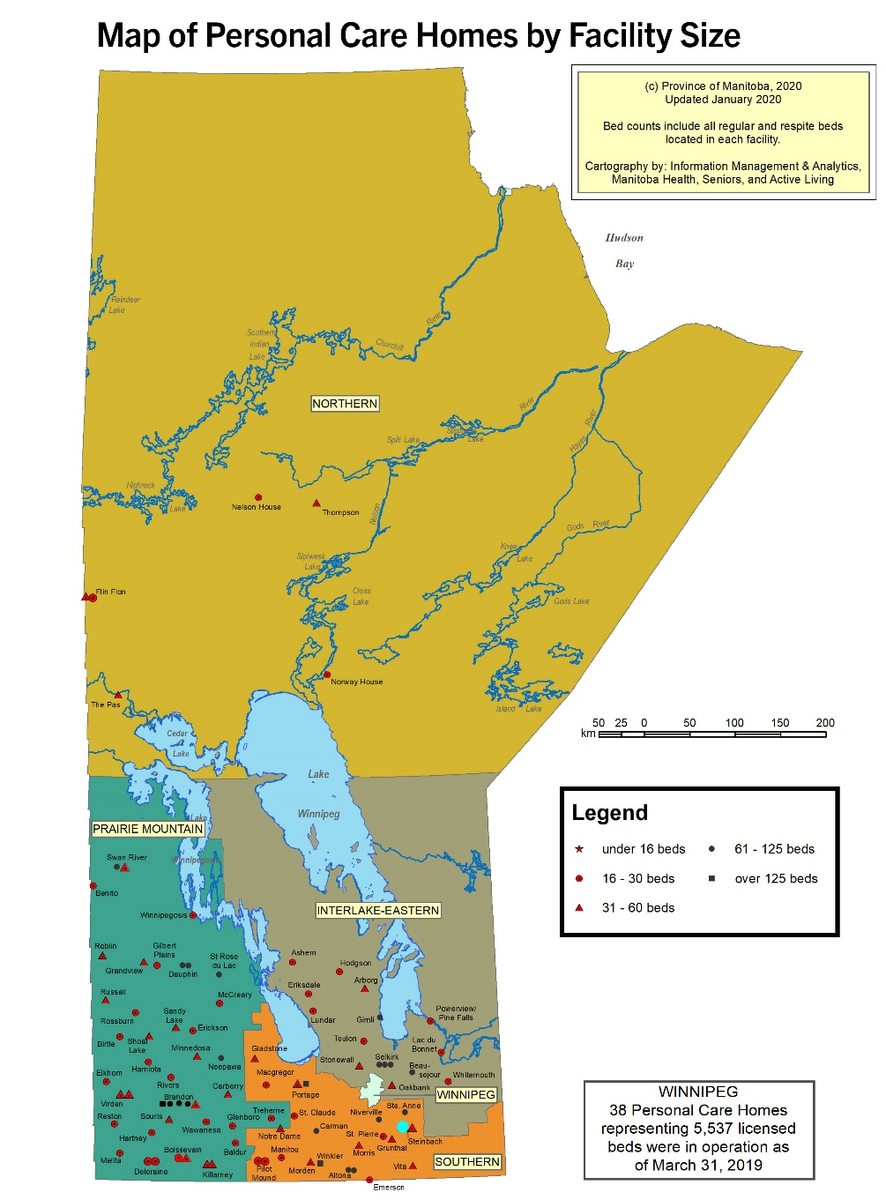

Figure 14-4: Personal care homes found in Manitoba
©2020 Centre on Aging, University of Manitoba
Notes:
How to cite this graphic:
Figure 14-4: Personal care homes found in Manitoba. Reprinted from Facts on Aging: Health care and community services, by the Centre on Aging, retrieved from http://www.umanitoba.ca/aging
Copyright 2020 by the Centre on Aging, University of Manitoba.

