Slide 1
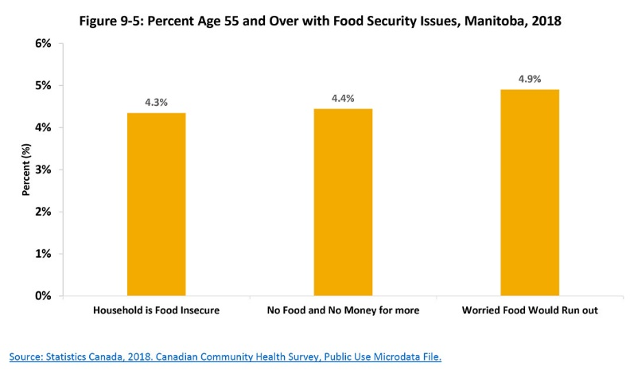
©2020 Centre on Aging, University of Manitoba
Notes:
How to cite this graphic:
Figure 9-5: Percent Age 55 and Over with Food Security Issues, Manitoba, 2018.
Reprinted from Facts on Aging: The older worker, by the Centre on Aging, retrieved from http://www.umanitoba.ca/aging
Copyright 2020 by the Centre on Aging, University of Manitoba.

