Slide 1
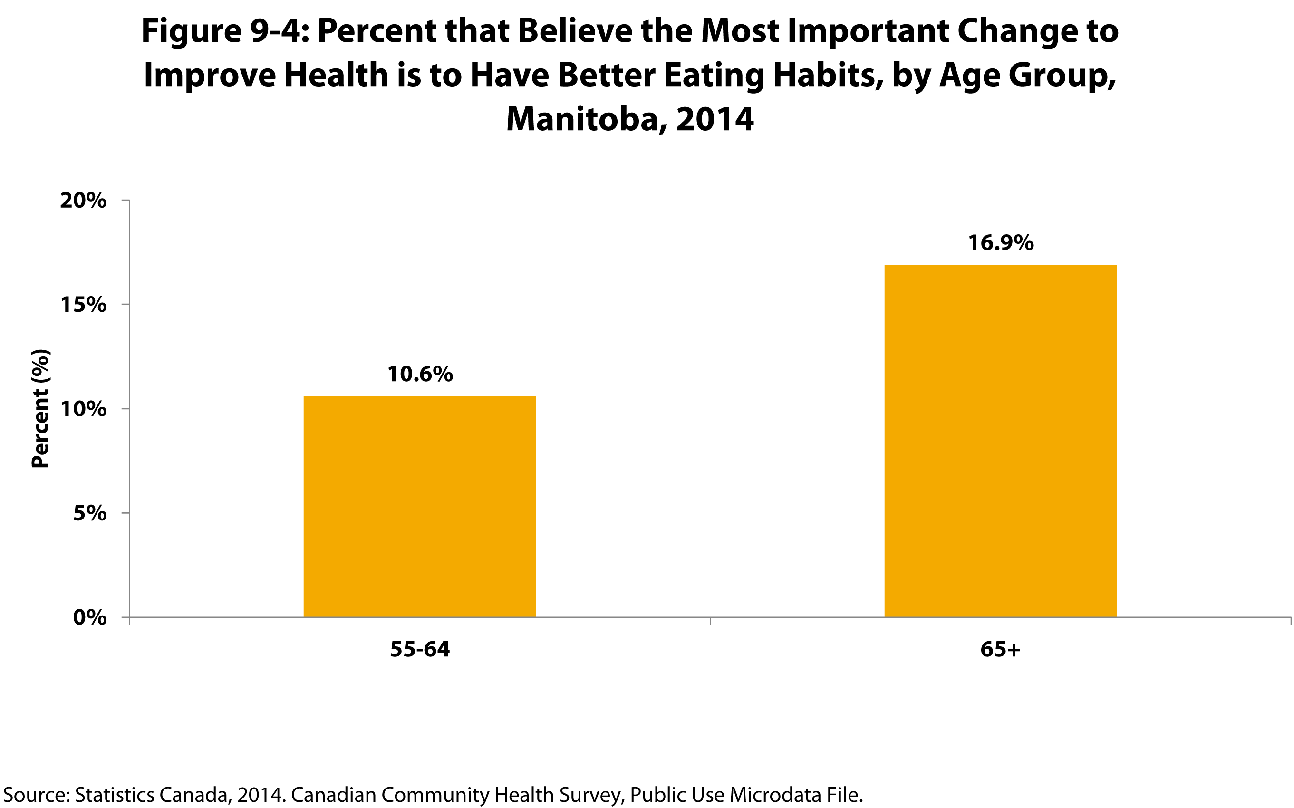
©2017 Centre on Aging, University of Manitoba
Notes:
How to cite this graphic:
Figure 9-4: Percent that Believe the Most Important Change to Improve Health is to Have Better Eating Habits, by Age Group, Manitoba, 2014. Reprinted from Facts on Aging: Healthy Eating by the Centre on Aging, retrieved from http://www.umanitoba.ca/aging
Copyright 2017 by the Centre on Aging, University of Manitoba.

