Slide 1
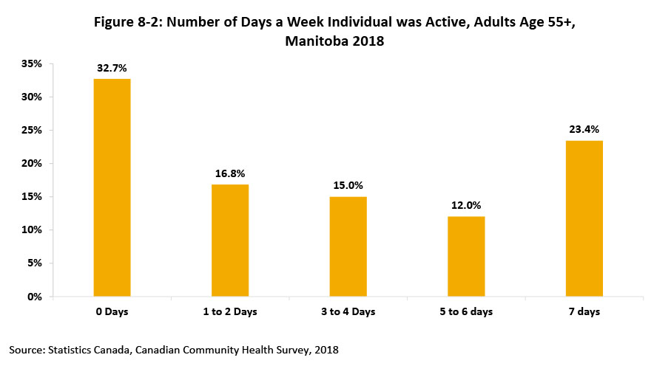
©2020 Centre on Aging, University of Manitoba
Notes:
How to cite this graphic:
Figure 8-2: Number of Days a Week Individual was Active, Adults Age 55+, Manitoba 2018 . Reprinted from Facts on Aging: Leisure and physical activity, by the Centre on Aging, retrieved from http://www.umanitoba.ca/aging
Copyright 2020 by the Centre on Aging, University of Manitoba.

