Slide 1
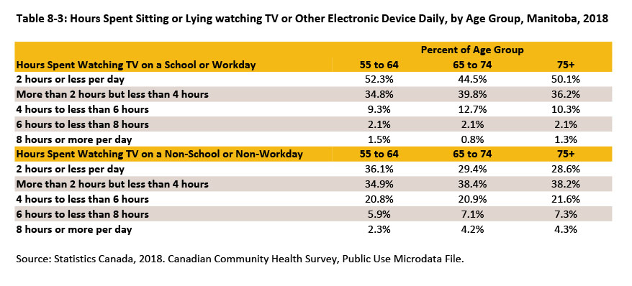
©2020 Centre on Aging, University of Manitoba
Notes:
How to cite this graphic:
Table 8-3: Hours Spent Sitting or Lying watching TV or Other Electronic Device Daily, by Age Group, Manitoba, 2018. Reprinted from Facts on Aging: The older worker, by the Centre on Aging, retrieved from http://www.umanitoba.ca/aging
Copyright 2020 by the Centre on Aging, University of Manitoba.

