Slide 1
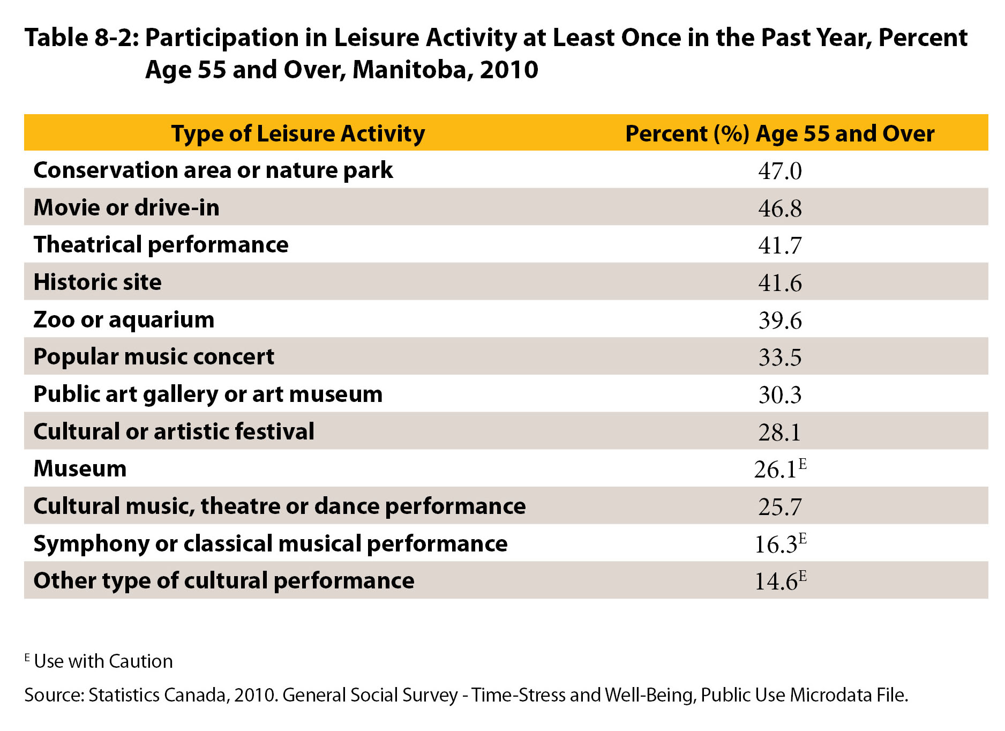
©2017 Centre on Aging, University of Manitoba
Notes:
How to cite this graphic:
Table 8-2: Participation in Leisure Activity at Least Once in the Past Year, Percent Age 55 and Over, Manitoba, 2010. Reprinted from Facts on Aging: Active Aging, by the Centre on Aging, retrieved from http://www.umanitoba.ca/aging
Copyright 2017 by the Centre on Aging, University of Manitoba.

