Slide 1
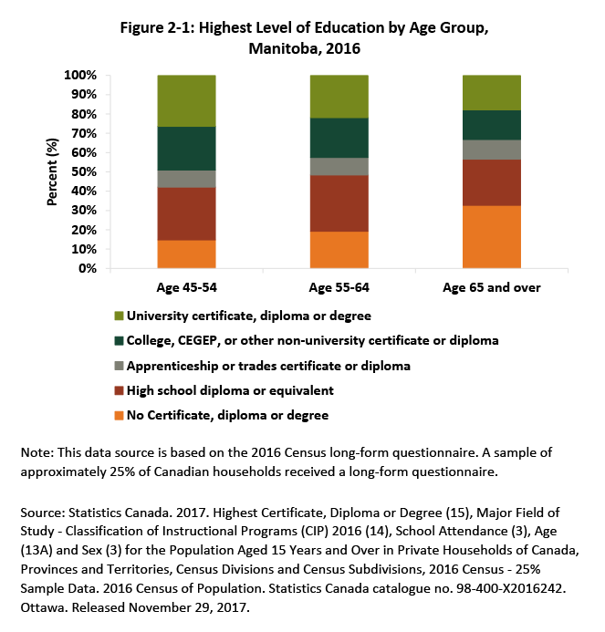
©2018 Centre on Aging, University of Manitoba
Notes:
How to cite this graphic:
Figure 2-1: Highest Level of Education by Age Group, Manitoba, 2016. Reprinted from Facts on Aging: Lifelong learning, by the Centre on Aging, retrieved from http://www.umanitoba.ca/aging
Copyright 2018 by the Centre on Aging, University of Manitoba.

