Slide 1
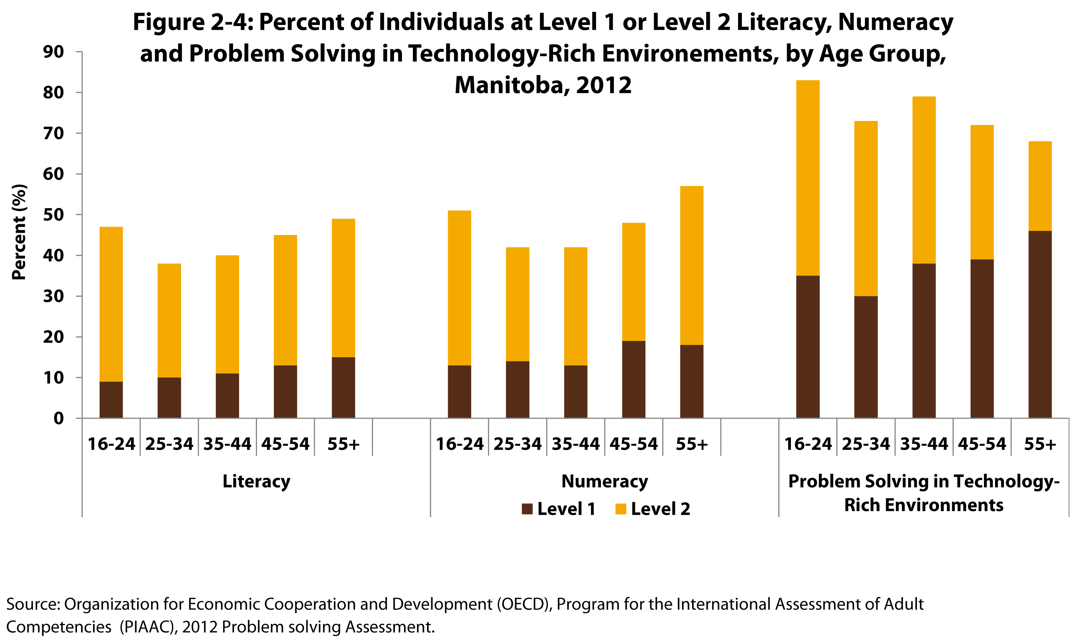
Notes:
How to cite this graphic:
Figure 2-4: Percent of Individuals at Level 1 or Level 2 Literacy, Numeracy and Problem Solving, by Age Group, Manitoba, 2012. Reprinted from Facts on Aging: Lifelong learning, by the Centre on Aging, retrieved from http://www.umanitoba.ca/aging
Copyright 2017 by the Centre on Aging, University of Manitoba.

