Slide 1
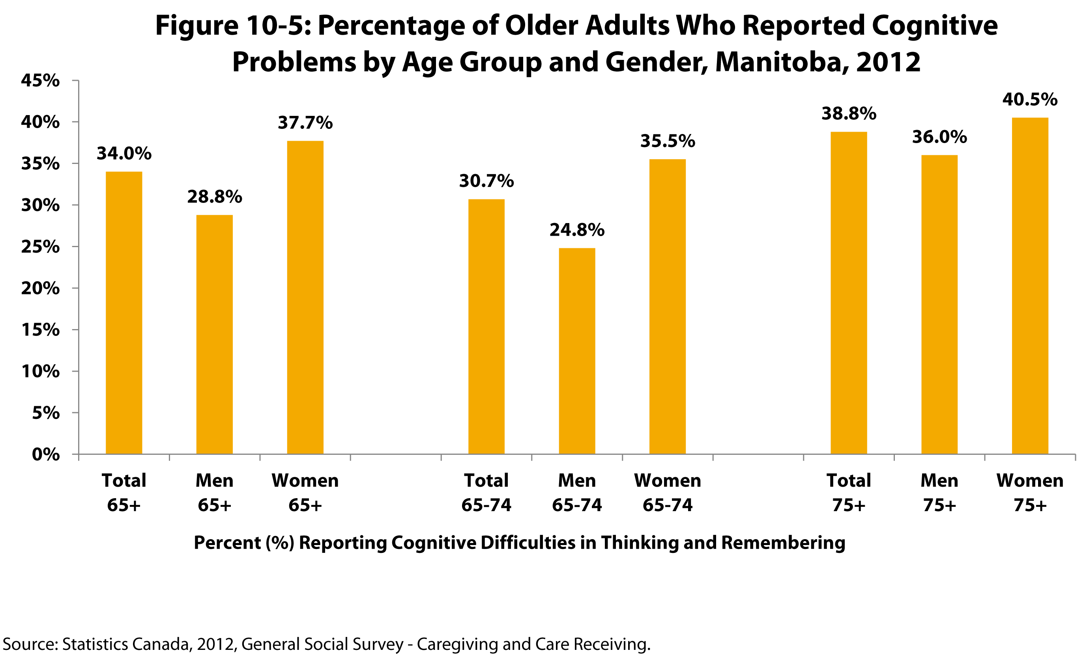

©2017 Centre on Aging, University of Manitoba
Notes:
How to cite this graphic:
Figure 10-5: Percentage of Older Adults Who Reported Cognitive Problems by Age Group and Gender, Manitoba, 2012 . Reprinted from Facts on Aging: Mental Health Status by the Centre on Aging, retrieved from http://www.umanitoba.ca/aging
Copyright 2017 by the Centre on Aging, University of Manitoba.

