Slide 1
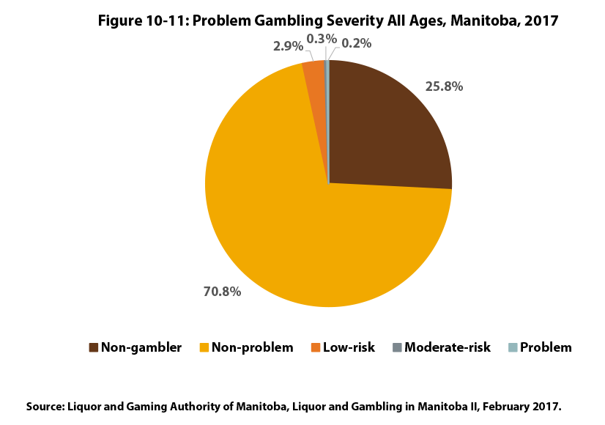

©2019 Centre on Aging, University of Manitoba
Notes:
How to cite this graphic:
Figure 10-11: Problem Gambling Severity Index Classification All Ages, 2017. Reprinted from Facts on Aging: The older worker, by the Centre on Aging, retrieved from http://www.umanitoba.ca/aging
Copyright 2019 by the Centre on Aging, University of Manitoba.

