Slide 1
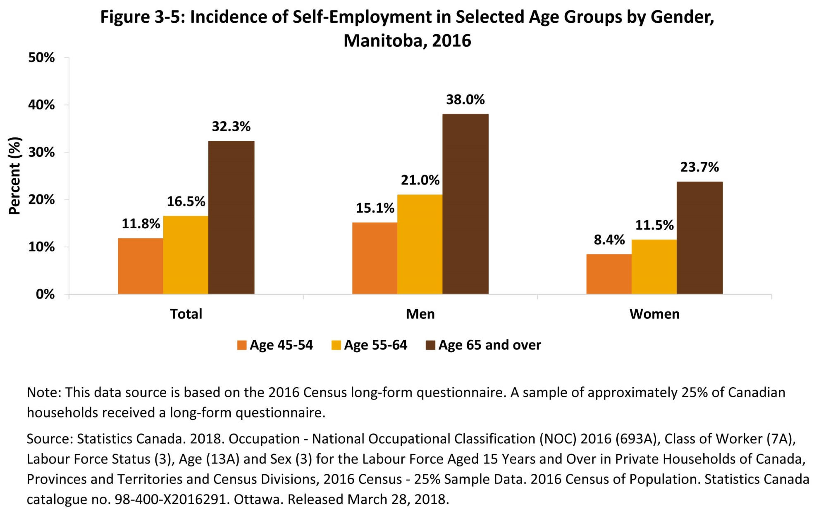
©2018 Centre on Aging, University of Manitoba
Notes:
How to cite this graphic:
Figure 3-5: Incidence of Self-Employment in Selected Age Groups by Gender, Manitoba, 2016. Reprinted from Facts on Aging: The older worker, by the Centre on Aging, retrieved from http://www.umanitoba.ca/aging
Copyright 2018 by the Centre on Aging, University of Manitoba.

