Slide 1
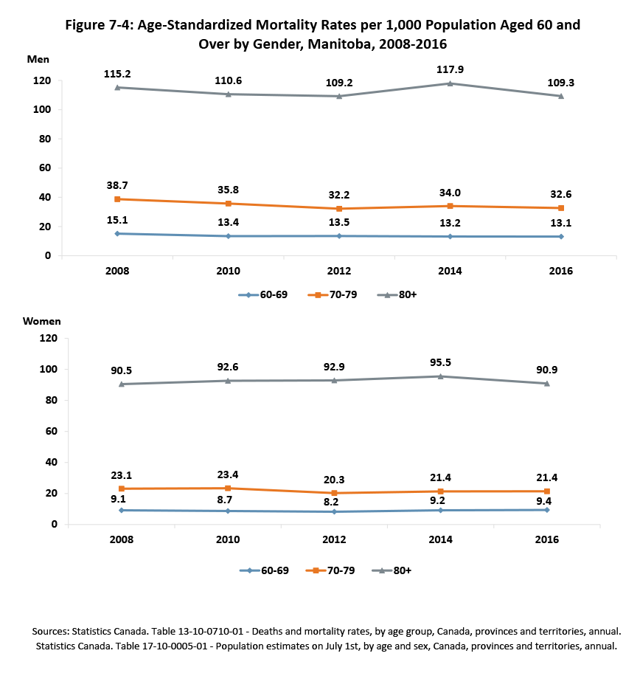
©2018 Centre on Aging, University of Manitoba
Notes:
How to cite this graphic:
Figure 7-4: Age-Standardized Mortality Rates per 1,000 Population Aged 60 and Over by Gender, Manitoba, 2008-2016. Reprinted from Facts on Aging: Physical health status, by the Centre on Aging, retrieved from http://www.umanitoba.ca/aging
Copyright 2018 by the Centre on Aging, University of Manitoba.

