Slide 1
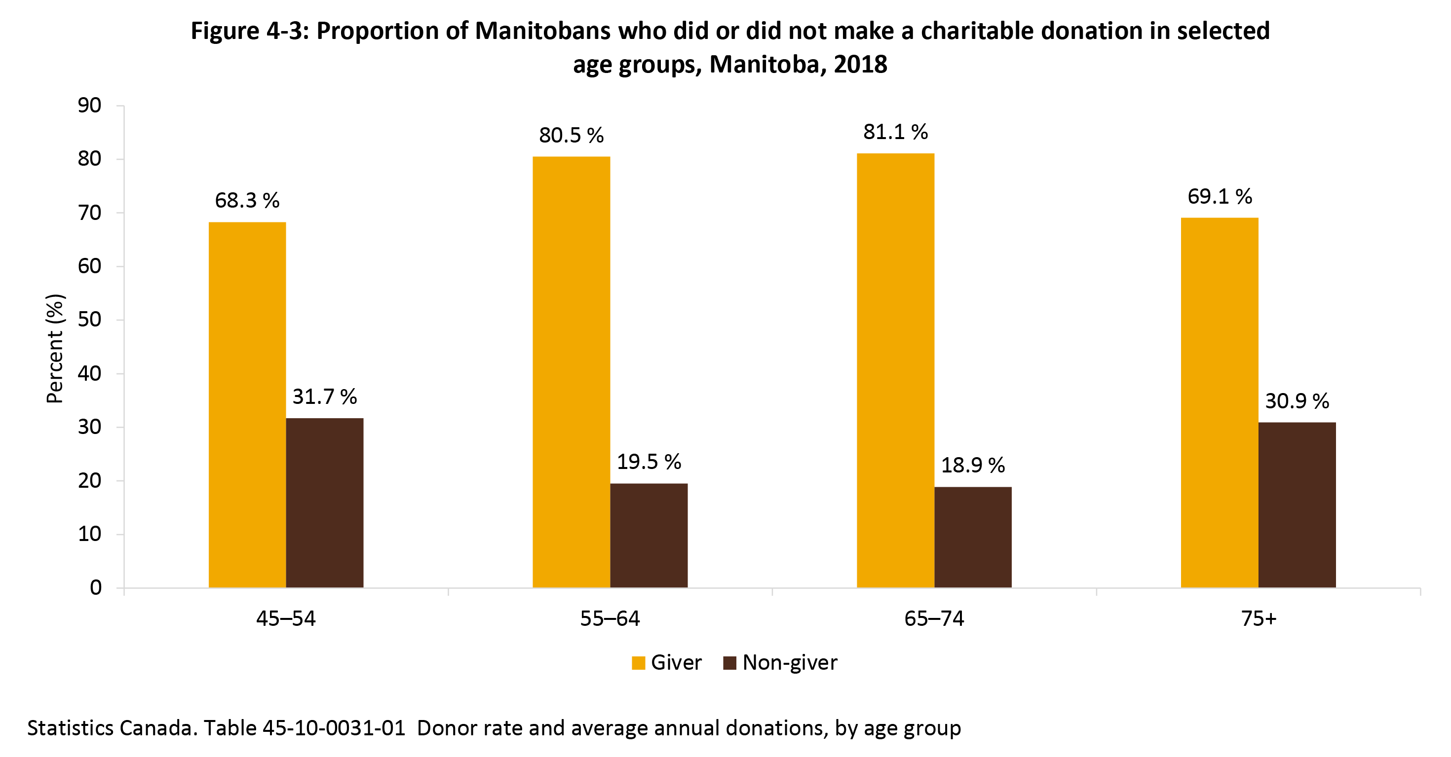
©2022 Centre on Aging, University of Manitoba
Notes:
How to cite this graphic:
Figure 4-3: Proportion of Manitobans who did or did not make a charitable donation in selected age groups, Manitoba, 2018. Reprinted from Facts on Aging: Volunteering and charitable giving, by the Centre on Aging, retrieved from http://www.umanitoba.ca/aging
Copyright 2022 by the Centre on Aging, University of Manitoba.

