Slide 1
Advanced FAST
WELCOME

Slide 2
Agenda
In this session we will:
Review FAST Reporting Basics
Explore FAST functions
Hierarchy levels/types, Wildcards & Ranges & more!
Get Hands On with Reporting
Look at Additional Reports
Advanced Functions
Customize, Pin & Share Reports

Slide 3
Expectations
By the end of today’s session you will be able to:
Run reports from the grid and menus
Use report filter options
View reports in different formats
Customize and Save your reports
Confidently produce and interpret financial reports for your department/unit

Slide 4
FAST Reporting Basics
FAST: What is it?
Financial Administration Support Tool
Houses 3 applications
Accounts Receivable
Budget Transfers
Finance Reporting

Slide 5
FAST Reporting Basics
Dynamic, web-based budgeting and reporting tool
Downloads data from Banner Finance and presents financial information in an easy-to-read format
Updates every morning

Slide 6
FAST Reporting Basics
FAST is accessed from the U of M homepage.
You will need to know your UMnetID & password
In FAST, select the Finance Reporting application…
Available applications in FAST will depend on the roles assigned to you for your current position.
Most people will have Finance Reporting as a minimum if working with UofM Funds.

Slide 7
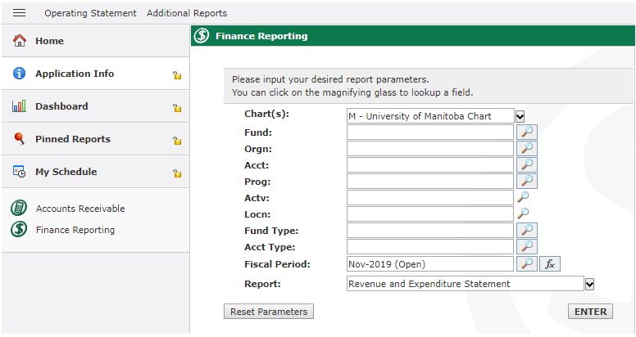
FAST Reporting Basics
The FAST Reporting homepage allows you to access
1.
2.
3.
Menus
Quick Access Tabs
Query Grid
Clear your query in one click
4.

Slide 8
FAST Reporting Basics
There are multiple reports available to you in FAST to help manage your budget , expenditures and revenue.
Each report can be:
Viewed in several ways
Customized by you
Saved to your personal dashboard
Reports can be accessed through the drop down menu on the grid or through the menus.

Slide 9
FAST Reporting Basics
Reports available in the drop down list include:
Revenue and Expenditure Statement
Endowment Report
Expenditures Only Report
Revenues Only Report
Grant Expenditures Report
Grant Revenues Report
Trust Report
Trust Capital Report
Transaction Details
Document Type Query
My Outstanding Purchase Orders and Requisitions
This Month Budget Changes
Trial Balance
Current year Actuals by Position
Current Year Budget by Position

Slide 10
FAST Reporting Basics
Reports available in the Operating Statement menu are:
Summary by Hierarchy
Summary by FOAPAL
Summary by Account Detail
Transaction Detail
Current Year Actuals by Position
Current Year Budget by Position
The first 3 reports include filter options upfront so that you can view in the format that best fits your needs right away.

Slide 11
FAST Reporting Basics
The filter options include:
The Additional Reports menu contains custom reports which you have access to. Currently these include budget reports.
Current Year | Project to Date | Annual Variance | Budget Status | User Defined
Comparative | Monthly Trend | Rev & Exp Variance | Quarterly Trend | Forecast
Date Range | Annual Trend | Budget Changes

Slide 12
FAST Reporting Basics
Key reports that can provide all of the financial information for your unit are:
Revenue & Expenditure Statement
Revenue Only Statement
Expenditures Only Statement
Transaction Detail Report
Document Query
These reports can answer most of your questions such as:
What is our available budget?
How much have we spent?
What was this transaction for?

Slide 13
FAST Functions
All FOAPAL elements are built into a ‘hierarchy’
Used to facilitate financial reporting
Upper levels of the hierarchy referred to as “levels”, “predecessors” or “types”
The last level of the hierarchy is referred to as “data enterable” level

Slide 14
FAST Functions
FAST allows you to:
Search for any element of the Chart of Accounts by selecting this icon
Use % as a Wildcard to provide available options when you may not have all the details
Use Ranges to obtain a series of information by including : in your search
Select varying Filter and Sort Options to design the report you need
Export any report to excel or PDF

Slide 15
Hands on Reporting
Let’s get started in FAST and work with these functions:
Running Reports
Drill downs
Filter Options & Searches
Wildcards & Ranges
Sort By and Levels options
Reviewing Base vs. Fiscal budget

Slide 16
Additional Reports
The Actuals By Position and Budget By Position reports display salary details and budget information
Ensure staff being paid on your FOP are valid employees for your area
Ensure staff being paid on your FOP have sufficient budget allocated
Necessary for correct salary/merit increases
Provides employee details from VIP (employee # and position #)
Both reports are available in the Operating Statement menu

Slide 17
Additional Reports
If you are managing the budget, the Budget Changes report allows you to ensure adjustments are on track
Displays the history of budget transfers for the specified period (month)
This report is displayed in the Additional Reports menu

Slide 18
Advanced Functions
You can customize your reporting experience in FAST by:
Hiding report columns, group data and change how information is sorted on demand
Going back to reports you ran during a session using the Return to Report function
Saving your reports - using the Pinned Reports function
Emailing a report directly from FAST to a colleague
Setting up a Personal Dashboard with your custom reports & graphs for quick access

Slide 19
Advanced Functions
Sharing Reports
Pinned Reports can be shared with colleagues via email.
You can send a PDF, excel, XML or the option to run the report directly in FAST.
Note: The execute in FAST only works for individuals who have access to the funds/orgs within the report.

Slide 20
Advanced Functions
Sharing Reports - Sample email
A link will be sent to open the report in the desired format

Slide 21
Session Summary
FAST is a powerful reporting tool
Many ways to produce reports
Every financial transaction that occurs is recorded and can be viewed in FAST Reporting
Updates every morning
Remember…
Higher levels of the FOAP
Fund Types / Account Types
Wildcards
Various views & menus to produce reports
Customize, PIN & Share your commonly used reports

Slide 22
Additional Training
Banner & FAST Training
Introduction to Aurora Finance
Aurora For Researchers
BANNER Navigation Fundamentals
Journal Entries & Interdepartmental Charges (JE’s & IDC’s)
Advanced FAST
External Invoicing (FAST A/R)
Budget Transfers
Concur
Travel and Expense Management
EPIC
Introduction to EPIC
EPIC – After the Order
Contracts
How many certificates can you achieve?

Slide 23
Assistance
Need additional support?
Aurora Finance Customer Service Desk for system support at 204-480-1001 or aurora_finance@umanitoba.ca
Guides, Manual & eLearns available on the Aurora Finance page
Visit the Aurora Finance website Training & Resources Hub
http://umanitoba.ca/computing/renewal/aurora/finance/index.html
ASK Aurora! Sessions
Subscribe to our client mailing list to stay up to date!
http://umanitoba.ca/computing/renewal/aurora/finance/subscribe_to_list.html

Slide 24
Questions

Slide 25
Thank you!

