Slide 1
External Invoicing & FAST AR

Slide 2
Session Objectives
At the end of this session, you will be able to:
Understand the External Invoicing process
Learn about policies, procedures, roles and responsibilities, collection, tax implication
Manage External Invoicing and Accounts Receivable using FAST AR tool

Slide 3
Benefits of an External Invoicing System
Allows to apply the Revenue Recognition principle:
Record revenue when earned,
not when payment received
Revenues are earned when goods/ services are transferred to customers
Makes Budget Reconciliation easier

Slide 4
Benefits of FAST AR
Easy to navigate = USER friendly!
AND offers great functionalities:
Ability to copy invoices
Print multiple invoices at once
Send invoices by email
Add attachments to your invoice
Real Time Reports
Approval Functionality

Slide 5
External Invoicing
Occurs when the University provides a good/service to an external organization or individual (customer)
Example:
Funding agency for a research grant
Salary sharing agreement
Billing tenants for monthly lease payments
Laboratory Tests/ Analysis
Technical Service Agreement
Conferences/ Workshops/ Short Courses

Slide 6
External Invoicing
Roles & Responsibilities detailed in the “Invoicing and Collections” policy and procedures documents
Details responsibilities of General Accounting and the Faculties/Units
MAKE SURE YOU READ!!
http://umanitoba.ca/admin/governance/governing_documents/financial/387.html

Slide 7
Roles & Responsibilities
Faculties/Units:
Obtain training on FAST Accounts Receivable
Assess credit risk of customer prior to sale
Provide good or service to customer
Understand revenue recognition principle –
do not invoice before goods are transferred/ service is provided
bill on time! – in the month when the revenue is earned
pay attention to specific deadlines for contract-related billings

Slide 8
Roles & Responsibilities
Faculties/Units cont’d…
Record, print and mail/email invoice to customer
Ensure accuracy of the accounting entries of your invoice (FOAP)
Select a descriptive revenue account
Assess and assign correct taxes on invoice
UofM is GST & PST registrant
Correspond with customer on any invoice discrepancies/issues
Request cancellation/adjustment to an invoice if necessary

Slide 9
Roles & Responsibilities
Faculties/Units cont’d…
Review the AR Aging report on a regular basis
Follow up with customer regarding outstanding invoices
Inform General Accounting of any collectability issues that may exist
Bear the subsequent costs of all collection activities, i.e. bad debt expense (if written off), collection agency/legal fees

Slide 10
Roles & Responsibilities
Financial Services:
Administer the FAST Accounts Receivable system
Create customer ID’s/ manage customer database
Apply customer payments to invoices
Issue statement/reminders to customers and work with units and Legal Counsel on pursuing further collection efforts if required
Write off invoices deemed uncollectable

Slide 11
*New*: FFSA & TSA
Fee For Service Activities:
generally stand-alone/short-term testing or consulting activities where results are not normally being used in the course of traditional academic research (i.e. do not form the basis of a graduate student project or may not be publishable) and the services are generally being conducted to earn income for use in research-support

Slide 12
*New*: FFSA & TSA
Read the guidelines to learn about the FFSA:
http://umanitoba.ca/research/media/Fee-For-Service_Activities_Guideline.pdf
Highlights related to billing:
TSA must be in place when doing business with External Organisations (overhead 40%)
Institute to Institute disclaimer must be in place when doing business with External Post-Secondary Institutions (no overhead)
No TSA is required for Internal University of Manitoba Clients (no overhead, ID charge)

Slide 13
*New*: FFSA & TSA
Invoices must be issued through FAST AR for all Fee-For-Service Activities with external parties
Assess Sales Taxes similarly to any other sales & services invoices depending on the commodity provided under the agreement
Do not separately list the 40% overhead charge in the description block of the invoice; include it in the price of the service(s) being delivered
Ensure the split of the funds between FUND A (Direct Costs) and FUND B (Institutional Costs 40%) in the FOAP block

Slide 14
*New*: FFSA & TSA
New revenue accounts:
External
522023
External TSA FFSA
(Direct Costs)
524524
External Overhead (40%)
Post-Secondary
522024
Post-Secondary FFSA (100%)
Internal
532017
Internal-Fee for Service

Slide 15
Payments
UofM Remit-to Address:
University of Manitoba
General Accounting
315 Administration Bldg.
Winnipeg, Manitoba R3T 2N2
We accept:
Cheques
Cash
Interact (can be made at the Cashiers’ Office)

Slide 16
Payments
UofM Cash Control Policy and Procedure: http://umanitoba.ca/admin/governance/governing_documents/financial/389.html
Cash Definition: all forms of payments
Deposit Cash at the earliest practical opportunity, but in all cases by the next business day
Use Department Deposit Report Form: http://umanitoba.ca/admin/financial_services/secure/index.html

Slide 17
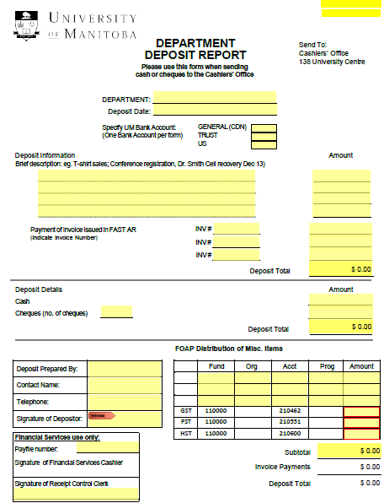
Department Deposit Report

Slide 18
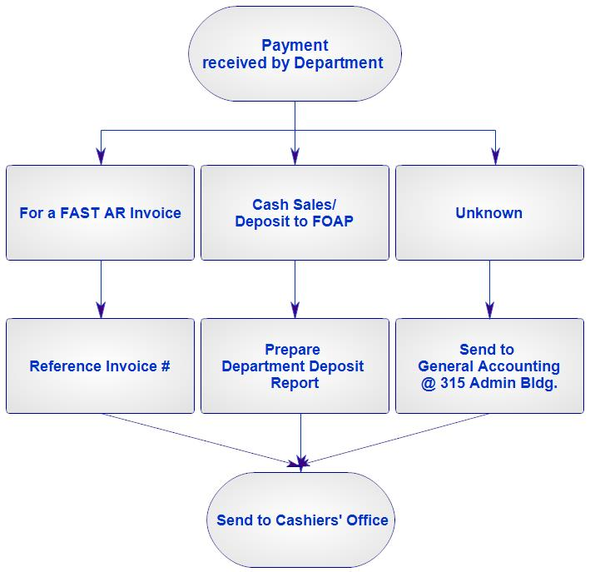
Payments

Slide 19
Payments
We do not accept Credit Card Payment centrally
Units may be set up with a Merchant Account
Learn about requirements and regulations:
http://umanitoba.ca/admin/financial_services/media/new_merchant__FAQ(2).pdf
Consider fees (charged to the unit)
Consider Administration
Contact us at 9574 for more information
When sending your payment information to RCGA, reference Invoice number for accurate payment application (where applicable)

Slide 20
Payments
Wire Transfers
Direct Deposits
Remittance Advises to be directed to
accounts_receivable@umanitoba.ca
Currency:
CAD and USD
Currency exchange gain or loss is absorbed by the billing unit

Slide 21
FAST AR Assistance
General Accounting 474-8362 accounts_receivable@umanitoba.ca
Aurora Finance Customer Service
480-1001 Ext 3 - Application Assistance
Ext 4 - Security Assistance aurora_finance@umanitoba.ca

