Slide 1
Introduction to…..

Slide 2
Agenda
Understand Aurora Finance and its suite of software available
Gaining access to Aurora Finance and Security
Use the FAST Tool for financial reporting needs
Navigate within BANNER

Slide 3
What is Aurora Finance?
Aurora Finance is the University of Manitoba’s fully integrated suite of administrative application software for financial management.
Every accounting transaction and associated detail is recorded and reported within the system
There are 5 primary Financial Applications
BANNER Administrative Forms
Core systems for Finance and Student information (G/L)
FAST (Financial Administrative Support Tool)
Financial reporting, budget transfer and external invoice tool
Concur
Travel & Expense Management System
EPIC
E-Procurement system for purchases & payments
UMPlan
Planning and Budgeting tool

Slide 4
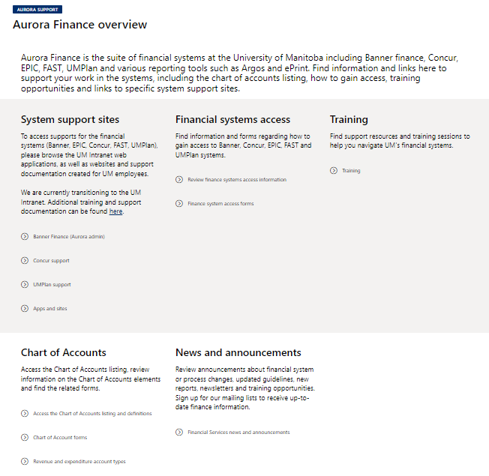
Aurora Finance Customer Service
Aurora Finance Customer Service provides Customer Service, Access & Training for the Aurora Finance financial systems.

Slide 5
Aurora Finance Training
Banner & FAST Training
Introduction to Aurora Finance
Aurora For Researchers
BANNER Navigation Fundamentals
Journal Entries & Interdepartmental Charges (JE’s & IDC’s)
Advanced FAST
External Invoicing (FAST A/R)
Budget Transfers
Concur
Travel and Expense Management
EPIC
Introduction to EPIC
EPIC – After the Order
EPIC Contracts
How many certificates can you achieve?

Slide 6
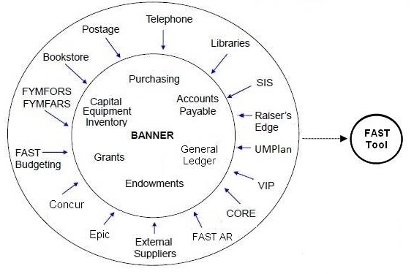
System Overview

Slide 7
U of M Finance Terminology
The Chart of Accounts is a series of codes used to account for every financial transaction that occurs at the University.
The University’s new Chart of Accounts consists of six elements commonly referred to as a FOAPAL. The acronym is broken down as follows:
F | Fund | 6 digits
O | Organization | 6 digits
A | Account | 6 digits
P | Program | 4 digits
A | Activity | 6 digits
L | Location | 6 digits

Slide 8
U of M Finance Terminology
Fund
Used for identifying the source of funds. Examples are Operating, Research, Endowment, etc.
Organization
Identifies who spent the money. Usually a unit of budget responsibility and/or department(s) within an institution. This can be a faculty, school, department or
administrative unit.
Account
Identifies what the money was spent on, the type of revenue, and also used to define assets and liabilities.
Program
Classifies the revenue or expense as defined by the purpose of your Unit or
Grant.
Activity
Used to define unique activities such as Campus Beautification Day, Emergency Preparedness activities, etc.
Location
Optional in Aurora and cannot budget by this category. Primarily used by, but not limited to, the Fixed Assets module.

Slide 9
U of M Finance Terminology
FOP…What is a FOP?
FUND (6 digits) | Identifies the source of funding eg: Operating, Research, Endowment
ORGANIZATION (6 digits) | Who spent the $$? Identifies responsibility. eg: faculty, school, department, unit
PROGRAM (4 digits) | Classifies the expense or revenue according to purpose/function eg: Instruction, Research, Support etc.

Slide 10
FOP: What is it?
FOP Examples
120012 333000 1100
Startup Forestry Academic
K. Smith Dept Expense
300236 |  | 333000 |  | 2000
MB Conservation Grant |  | Forestry Dept |  | Revenue

Slide 11
U of M Finance Terminology
What is a FOAP?
Additional code is the ACCOUNT which details what the funding was spent on or where the funding came from.
Examples:
Revenue | 562001 564001 | Federal Grant Revenue Province of MB Grant Revenue
Payroll | 63210 68000 | Research Associate Salary Employment Insurance
Expenditures | 706107 726411 | Lab Equipment <$2500 Scientific/Research Equipment >$2500

Slide 12
U of M Finance Terminology
FOAP Examples
120012 | - | 333000 | - | 706105 | - | 1100
Startup K. Potter |  | Forestry Dept |  | Chemicals |  | Academic Expense
300236 | - | 333000 | - | 66201 | - | 2000
MB Conservation Grant |  | Forestry Dept |  | PT Student Support Casual |  | Sponsored Research Expense

Slide 13
U of M Finance Terminology
What is a FOA?
Excludes the Program code identifying the purpose of the Unit
Used only in UM Plan for planning and budgeting
Example:
300236 - 333000 - 66201
MB Forestry PT Student Conservation Dept Support Casual Grant

Slide 14
The FOAP
All FOAP elements are built into a ‘hierarchy’
Used to facilitate financial reporting
Upper levels of the hierarchy referred to as “levels”, “predecessors” or “types”
Last level of the hierarchy referred to as “data enterable” level

Slide 15
The FOAP
Fund Helpful Hints:
Funds are built into a hierarchy to facilitate financial reporting
Most popular funds are:
Name | Fund Type | Data Entry Prefix
Unrestricted Operating Funds | 01 | 1
Internally Restricted Operating Funds | 11 | 12
Research Grants | 28, 30 | 3

Slide 16
The FOAP
Accounts are broken down into 8 different Account types:
10 Assets
20 Liabilities
30 Control Accounts (never used for data entry)
40 Fund Balance
50 Revenue
60 Salaries and Benefits
70 Non Salary Expenditure
80 Fund Transfers

Slide 17
The FOAP
Main account types you will use are :
Salaries & Benefits…data entry level is 5 digits
All other accounts…data entry level is 6 digits
Name | Account Type | Data Entry Prefix
Revenue | 50 | 5
Salaries & Benefits | 60 | 6
Non Salary Expenditures | 70 | 7

Slide 18
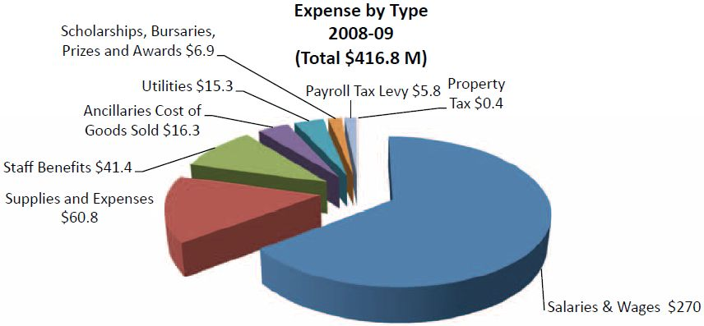
The FOAP
Impact of Account Codes:

Slide 19
The FOAP
Why are Organization & Program codes important?

Slide 20
FOAPAL: What is it?
Addition of 2 other elements:
Activity= Used to define unique activities to the University (e.g. Pandemic planning, flood preparation activities)
Location = Primarily used, but not limited to the Fixed Assets module – identifies location of capital assets (e.g. 404A Administration Bldg)

Slide 21
Aurora Finance Security
Gaining access to the University Financial Systems
Complete the Aurora Finance Systems Access Request form
Identifying which systems access is required
Indicating if a user needs to create transactions and/or report on FOPs, FOAPs, or FOAPALs
ie. Journal Entries, ID Charges, Budget Transfer
Different access required for support staff type role and a Researcher

Slide 22
Aurora Finance Security
Access is based on what Funds and Orgs a user is responsible for Example:
Employee who needs Dean’s Office Agriculture will have access to:
Fund 110000 (Operating Fund) and
Organization 312000 (Dean’s Office)
Access can also be given according to a fund/org hierarchy for example:
Fund Type 11
Fund Type 28
Org pred 3440

Slide 23
Aurora Finance Security
Type of Access
Query & Posting capability OR
Query only OR
Posting only
Aurora does not provide security over the Account (FOAP) element – any user can view and post to all accounts (including salaries)

Slide 24
FAST
FAST: What is it?
Financial Administration Support Tool
Houses 3 applications
Accounts Receivable
Budget Transfers
Finance Reporting

Slide 25
FAST
Dynamic, web-based budgeting and reporting tool
Downloads data from Banner, stores it in FAST database and presents financial information in an easy-to-read and understandable format
Updates every morning

Slide 26
Check Budget Available
Exercise
Determine the amount available to spend on a FOAP and find detail on a transaction:
View the Expenditures Only report, as follows.
At the Main Menu, leave blank to see all FOAP combinations you are authorized to see.
Select the Fiscal Period January 2018
Select the Expenditures Only Report from the Report drop-down list.
Select ENTER to generate the report.
View the Budget Available column total.
Drill down on the Unrestricted blue hyperlink ‘110’ until you get to the desired level of detail for org 312200, Animal Science
Find account code 706003 and click on the amount $62.22
Find Invoice # I2045266 for $7.71, click on the document to find the description of what the amount was for.

Slide 27
Budget Checking
Something to remember:
Budget Checking occurs for the combined FOP upon creating entries against the FOP
Account is “ignored” which allows you to be overspent in one account (e.g. Printing) and under spent in another (e.g. Telephone, Equipment rental)

Slide 28
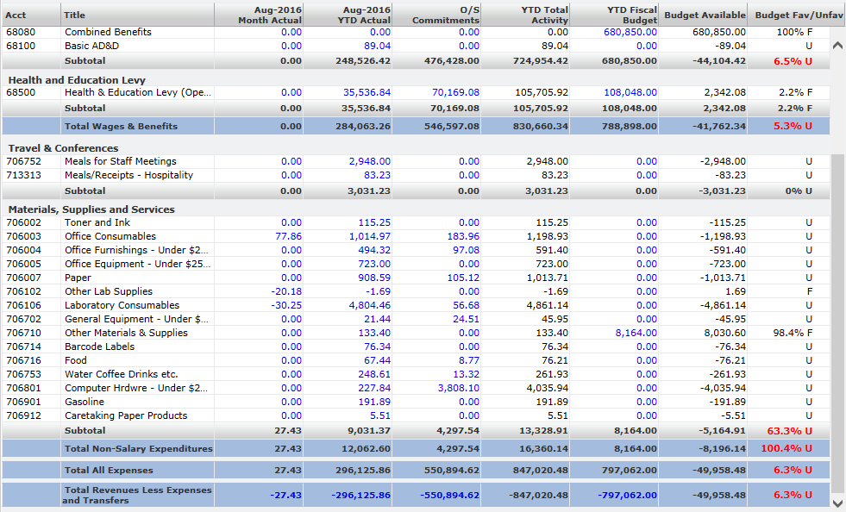
Budget Example
overspent
under spent
overspent

Slide 29
Banner Finance
Aurora Finance
Module
Page
Page
Key Block
Module
Info Block
Record
Structure of Banner

Slide 30
Page Acronym
Grant Code Inquiry Page
FRIGRNT
F – Financial System
R – Research Account Module
I – Type of Page – Query or “Informational”
GRNT – shortened version of page name

Slide 31
Page Acronym
Fund Organization Responsibility Tracking
FYMFORS
Use to query financial authorities on a fund, for a department/organization code

Slide 32
Financial Authorities
There are several types of Financial Authority or responsibility that can be provided to an employee of the University of Manitoba for each FOP or FA combination.
The types that exist are:
PS | Primary Financial Authority
 | The person ultimately responsible for the FOP or FA, also known as the principal investigator of a grant. Only one person per FOP or FA combination.
AS | Alternate Financial Authority
 | An employee who has been given the authority by the PS to sign off on expenditures for the FOP or FA combination.
PM | Payroll Mail
 | Person who will receive all payroll related printed materials. Only one person per FOP or FA combination. No financial authority rights.
VR | VIP Report Access
 | Person responsible for running the VIP payroll reports for the FOP or FA combination. No financial authority rights.
FS | Financial Services Responsibility
 | The accountant in Financial Services responsible for the FOP or FA combination.
http://umanitoba.ca/admin/financial_services/budgrant/signing_authorities.html

Slide 33
Summary
Aurora Finance is the suite of University of Manitoba’s financial systems
Chart of Accounts is comprised of the FOAPAL elements
Access to Aurora Finance and understand basic security rules
Use the FAST Tool for financial reporting needs
How Navigation within BANNER works

Slide 34
Assistance
Need additional support?
Aurora Finance Customer Service Desk for system & process support at 204-480-1001 or Aurora_Finance@umanitoba.ca
Visit the Aurora Finance website https://umanitoba.sharepoint.com/sites/um-intranet-aurora/SitePages/aurora-finance-overview.aspx
Aurora Chart of Accounts
Training
Manuals/Guides and more!
ASK Aurora! Sessions
Subscribe to our client email list! https://lists.umanitoba.ca/mailman/listinfo/aurora-finance-users

Slide 35
Questions

Slide 36
Thank you!

