Slide 1
Living in the In-Between
Creating a Sense of Wellness in Uncertain Times
Edgar French, Spiritual Care Coordinator
Jodie Schoenbeck, Student Support Case Manager
Jesse Singer, Student Support Case Worker

Slide 2
Presentation Goals
Affirm and attend to our difficult emotions in light of the uncertainty and turmoil we are living in
Explore the hidden opportunities and potential for self growth and the cultivation of wellness
Resource you with strategies, techniques and balanced perspectives on how to live more purposely and meaningfully in a time of insecurity

Slide 3
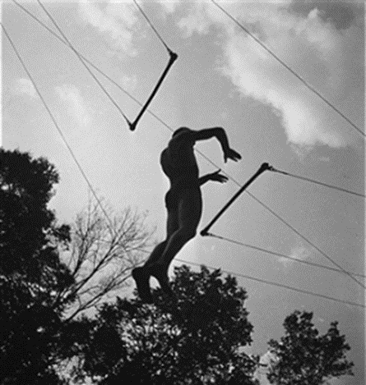
Living in the In-Between
Change is the only true constant in life
Liminal spaces are transitional/in-between spaces where our former ways of being are challenged and disrupted
Despite the discomfort felt in liminal spaces, they also harbor promise and opportunity

Slide 4
Liminal Check-In
Describe what it feels to live in the in-between for you, presently, using one word or phrase.
What concerns you the most about living in the liminal? What excites or produces hope within you?

Slide 5
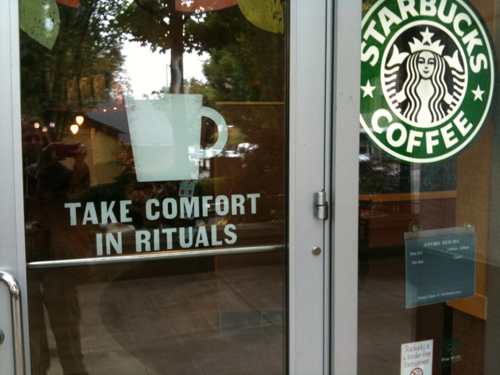
Rituals and Rhythm...
Living Off-Beat
Liminal spaces disrupt the daily rhythms and practices that give our lives cohesion, manageability and purpose
The loss or end of particular rituals/rhythm can also mean the beginning of new ones
Meaningful rituals can arise from liminal times –
https://stmikes.utoronto.ca/news/insightout-a-novel-ritual-for-a-novel-virus/

Slide 6

Living Off-Beat Check-in
How does it feel to be out of rhythm?
What new and life-giving rituals have arisen for you in life in pandemic?
What new daily practices and rhythms have your been intent on committing to, never had the chance, and finally now you can?

Slide 7

Being Attentive to the Inner-Life
Life in pandemic has produced new opportunities for stillness and contemplation
It offers us an opportunity to slow down our reactive tendencies, and become more aware of our thoughts and emotions

Slide 8
Keeping Quiet
Pablo Neruda
Now we will count to twelve
and we will all keep still
for once on the face of the earth,
let's not speak in any language;
let's stop for a second,
and not move our arms so much.
It would be an exotic moment
without rush, without engines;
we would all be together
in a sudden strangeness.

Slide 9
Fishermen in the cold sea
would not harm whales
and the man gathering salt
would not look at his hurt hands.
Those who prepare green wars,
wars with gas, wars with fire,
victories with no survivors,
would put on clean clothes
and walk about with their brothers
in the shade, doing nothing.
What I want should not be confused
with total inactivity.

Slide 10
Life is what it is about...
If we were not so single-minded
about keeping our lives moving,
and for once could do nothing,
perhaps a huge silence
might interrupt this sadness
of never understanding ourselves
and of threatening ourselves with
death.
Now I'll count up to twelve
and you keep quiet and I will go.

Slide 11
A Poetic Check-In
What does this poem mean for you?
How does it intersect your life at this moment?
Is there a word, phrase, image or feeling that the poem evokes in your and speaks directly to your condition?

Slide 12

Cultivating Creative Connections
Life in pandemic inhibits opportunities to find comfort in each other’s presence
We need to find creative ways to overcome imposed social limitations
Creative communal gatherings can help us transcend difficult emotions

Slide 13
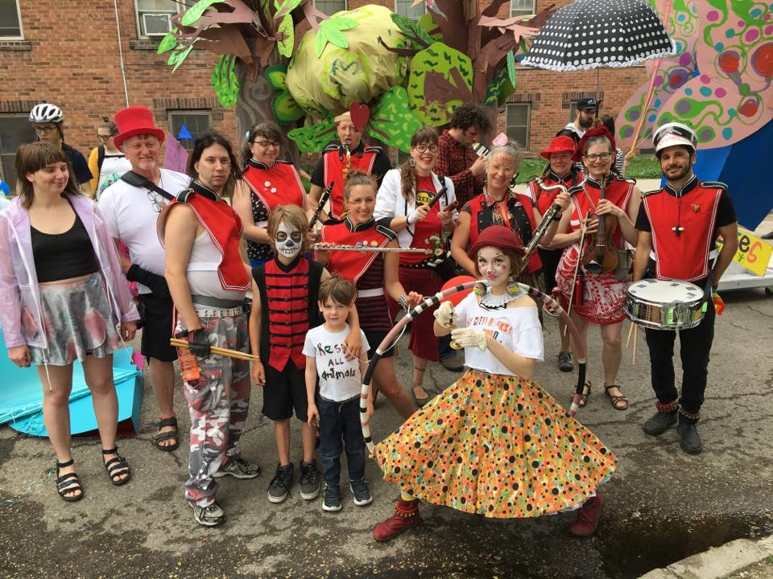
Creative Connections in Practice
Jesse’s Band –
Flaming Trolleys Community Marching Band at the annual art city parade circa 2019
Examples of creative meaningful alternative gatherigs:
https://www.ted.com/talks/priya_parker_how_to_create_meaningful_connections_while_apart
https://www.youtube.com/watch?time_continue=11&v=F_4NgWkIx_c&feature=emb_title

Slide 14
How to Access Support
Spiritual Care
To access Spiritual Care services remotely during the COVID-19 crisis, please e-mail or call the office directly and request an intake appointment, as a staff member is not in the office at present. Support is being offered over the phone.
Email or call in advance to confirm appointments:
edgar.french@umanitoba.ca
204-298-2467
Student Support Case Management
Call or email to make an appointment
Phone: 1-204-474-7423
Email: stadv@umanitoba.ca

