Slide 1
Student Accessibility Services
Supporting Students with Disabilities
Shanda Vitt Caitlin Dyck

Slide 2
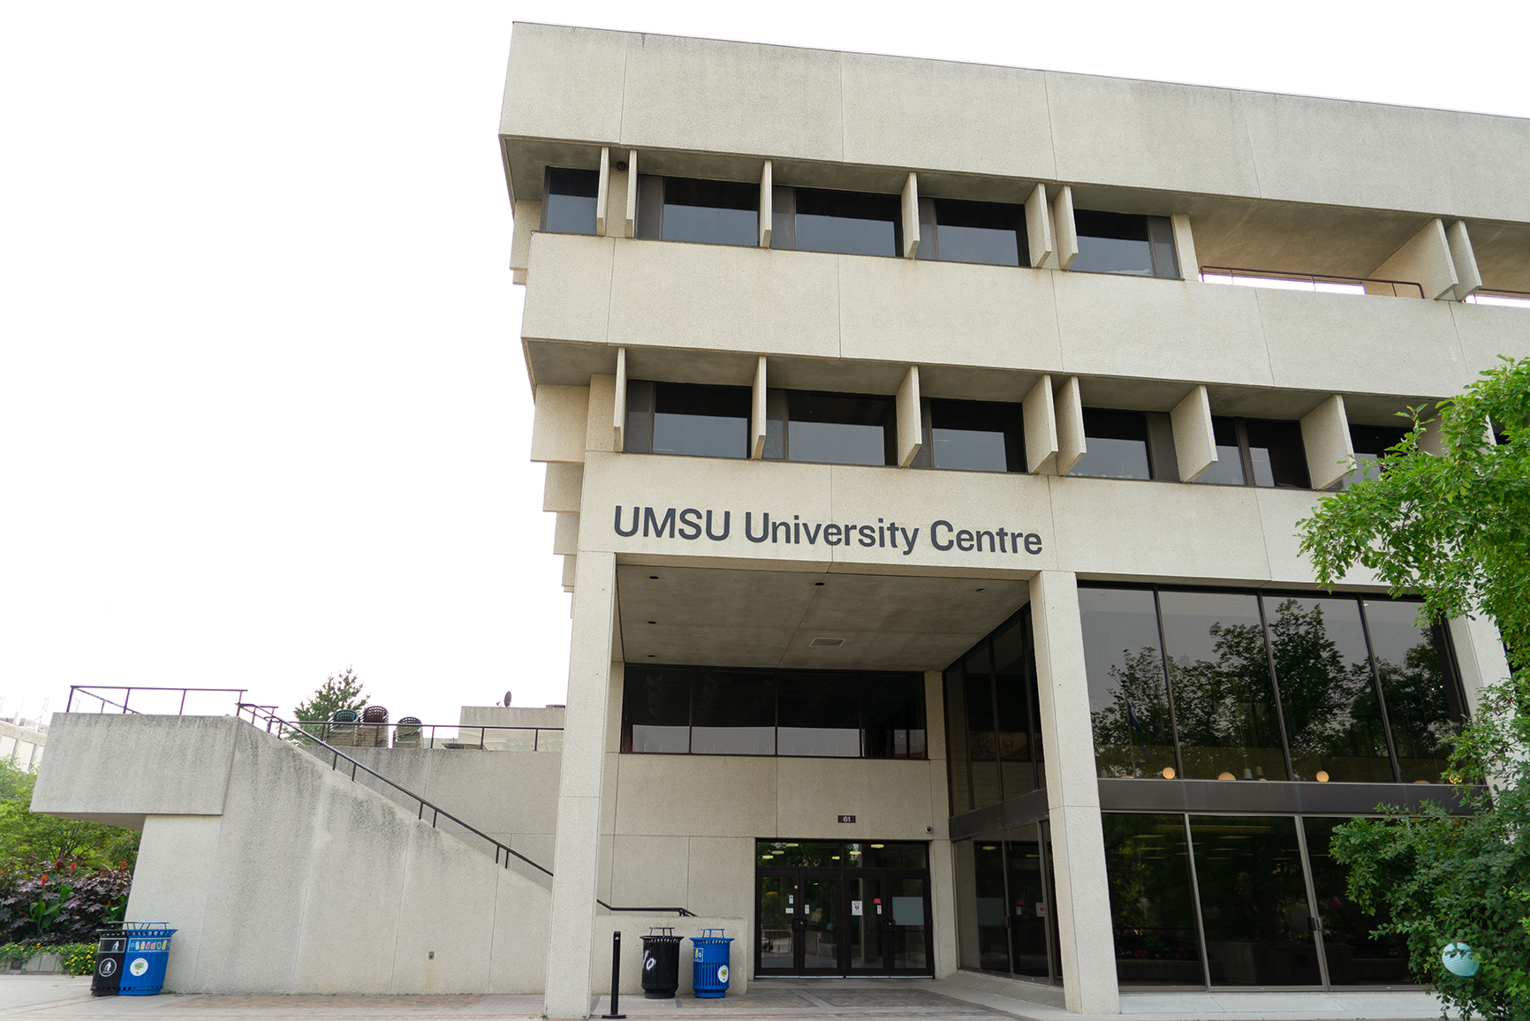
Our Team
Director
Coordinators (4)
Assistive Technologist
Exam Centre Staff
Accommodation Assistant
Program Staff
Front Desk

Slide 3
SAS Contact Information
Reception & Coordinator Staff
520 UMSU University Centre
Phone: 204-474-7423
Email: student_accessibility@umanitoba.ca
Assistive Technology Lab
335 UMSU University Centre
SAS Exam Centre
155 University Centre
Phone: 204-474-6213
Website
http://umanitoba.ca/student-supports/accessibility

Slide 4
Student Accessibility Services
The University of Manitoba has designated Student Accessibility Services (“SAS”) to facilitate the implementation of accommodations for students with documented disabilities.
If you are student with a diagnosed disability (permanent, chronic, or temporary) who may require academic accommodations, please contact SAS to learn more about their confidential support.

Slide 6
Student Accessibility Services
2018-2019 Student data
1517 students
44% Students with mental health disability

Slide 7
What is an Accommodation?
A different way of doing a task.
Allows the student work better and more efficiently.
Uses strengths to work around areas of weakness or barriers.
Levels the playing field without lowering the standards or compromising the integrity of a program.

Slide 8
Steps in Accessing SAS
Student contacts SAS to set up an intake/consultation (can be done by phone, web conference or in person).
Student provides SAS with medical documentation
from a registered medical health professional and includes a diagnosis and accommodation recommendations.
Student speaks with an Accessibility Coordinator to:
create individualized accommodation plan based on documentation, best practice, and student provided input.
uphold academic standards (eg: essential skills & technical abilities).
Continued partnership between student/faculty/SAS

Slide 9
Determining Accommodations
1. Student self report
2. Observation and Interaction
3. Information from a registered health professional
4. Determine an accommodation plan
AHEAD Documentation Practices

Slide 10
Confidentiality
Student signs a confidentiality and consent form.
Medical documentation, including diagnosis, is not shared unless student provides written consent to do so.
Standards set by FIPPA and PHIA are followed.
Letters of accommodation are sent to instructors at the request of the student.

Slide 11
Common Academic Accommodations
Test and exam accommodations
extra time, alternate space
Volunteer note-taking services
Sign language interpretation (ASL) and transcription service
Extensions
Assistive technology
Alternate formats for course material

Slide 12
Programs
ASL
Transcription
VNT
Academic Attendants
Peer Mentors (on hold)

Slide 13
Practicum/Clinical Accommodations
May be implemented based on consultation with the Accommodation Team, which is comprised of faculty and a SAS representative.

Slide 14
Manitoba Student Aid
There may be additional funding available to student with Permanent Disabilities through Manitoba Student Aid.
To learn more about funding possibilities, you can access the MSA website in the link below:
https://www.edu.gov.mb.ca/msa/planning-for-your-future/whats-available-to-me.html#Students-with-Permanent-Disability

Slide 15
FAQ’s About Accommodations / SAS Registration
Question:
SAS registration will appear on a transcript or degree parchment.
Answer:
SAS registration is confidential. It will not appear on your transcript or degree parchment.

Slide 16
FAQ’s About Accommodations / SAS Registration
Question:
Accommodations are not available to students in an online class.
Answer:
Accommodations are available for students with a disability for both on campus and online courses.

Slide 17
FAQ’s About Accommodations / SAS Registration
Question:
A mental health diagnosis does not enable a student to register with SAS and receive accommodations.
Answer:
A mental health diagnosis is a disability and therefore students could (and likely should) register with SAS.

Slide 18
FAQ’s About Accommodations / SAS Registration
Question:
Accommodations create an unfair advantage for students with a disability.
Answer:
Many students with a disability experience barriers to full participation on campus and in courses. Accommodations level the playing field without lowering standards or compromising program integrity.

Slide 19
FAQ’s About Accommodations / SAS Registration
Question:
Are all SAS students eligible for early registration.
Answer:
While some students may be eligible for an early registration date, this is not the case for everyone. Early registration is typically considered for students who require staff support, or for mobility reasons may need more time to get around campus.

Slide 20
How Can You Connect
No in person meetings at this time. However, we are happy to meet via:
Phone
Email
Web conference platforms (Zoom, WebEx, etc.)

Slide 21
Campus Resources for Students
Live Well @ UM: www.umanitoba.ca/livewell
Student Counselling Centre
International Student Centre
Psychological Services Centre
Student Support Case Management
University Health Service
Health & Wellness
Student Advocacy
Student Accessibility Services
Spiritual Care, Chaplains
Elders
Human Rights & Conflict Management
Academic Learning Centre
Sexual Violence Resource Centre
Sexual Assault Webpage - umanitoba.ca/sexual-violence/

Slide 22
Thank You & Questions
Front Desk & Coordinator Contact Information:
520 UMSU University Centre
Phone: 204-474-7423
Email: student_accessibility@umanitoba.ca

